Slide 1
Lakewood Hills
Preservation and Enhancement Committee Projects

Slide 2
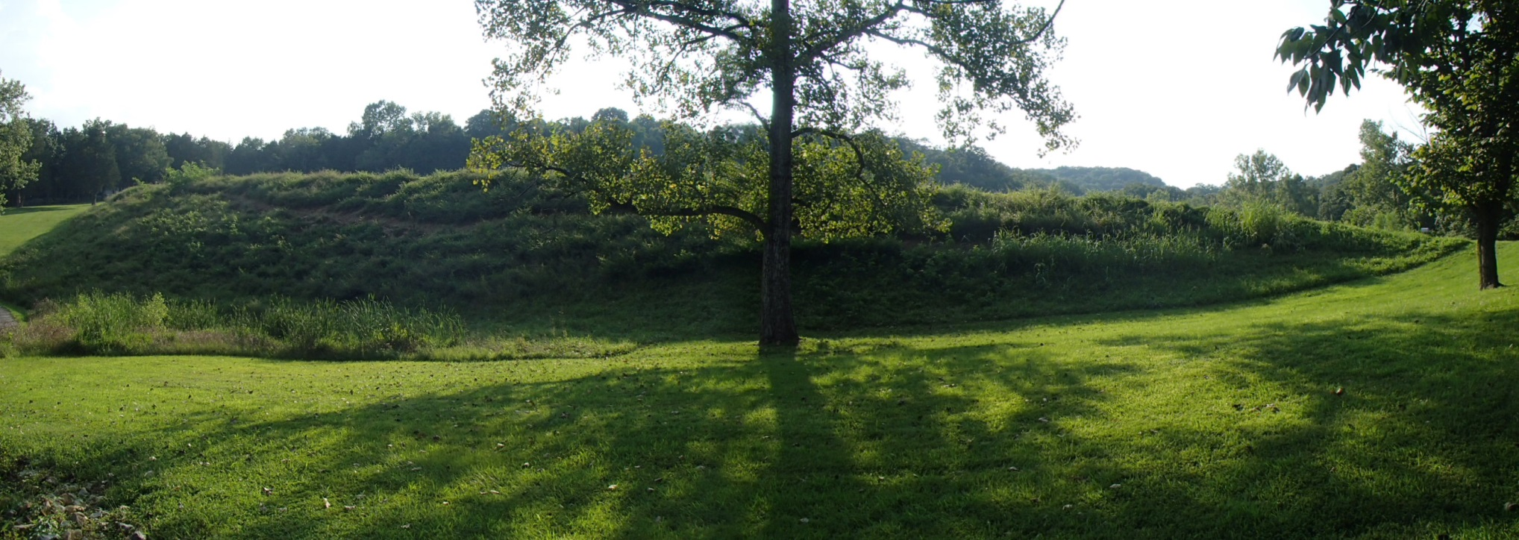
Pollinator Garden
Crystal Lake

Slide 3
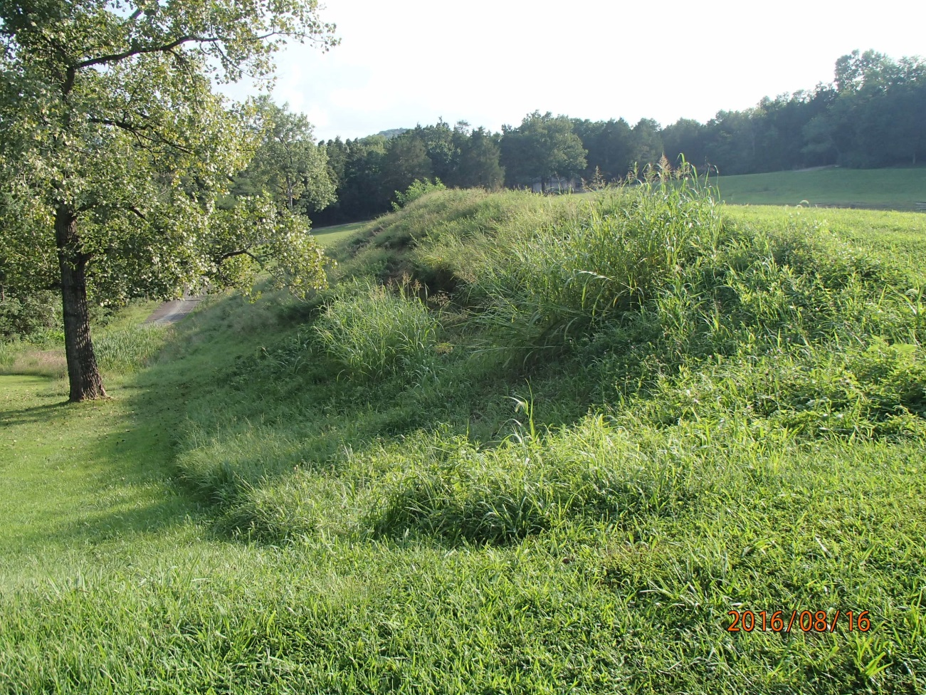
August 2016

Slide 4
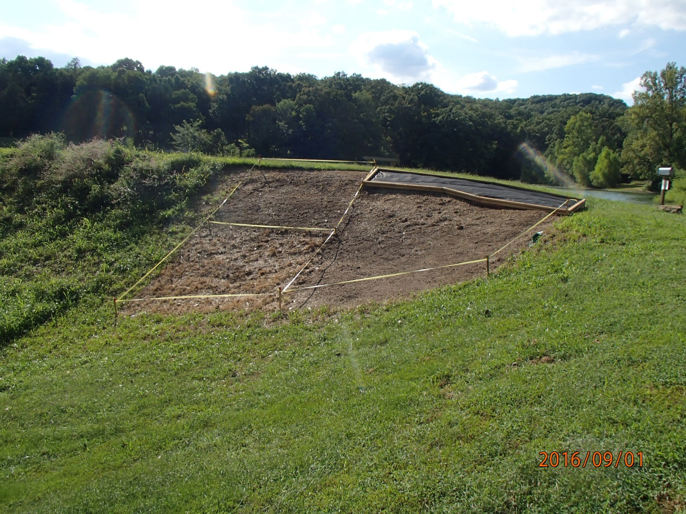
After a couple days of preparation and two weekends of herbicide application.

Slide 5
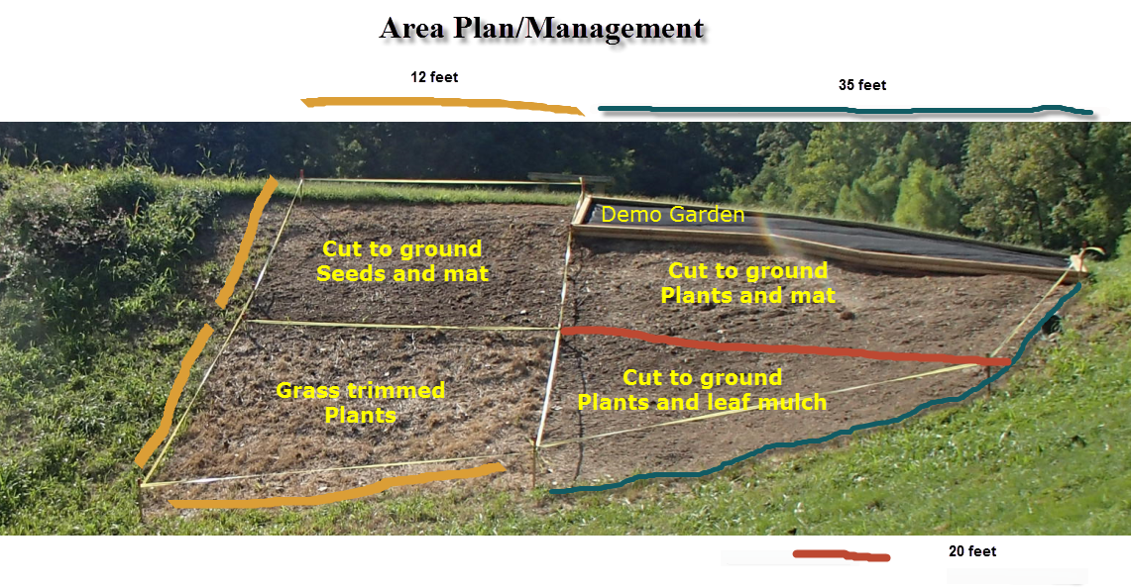
Garden Plan

Slide 6
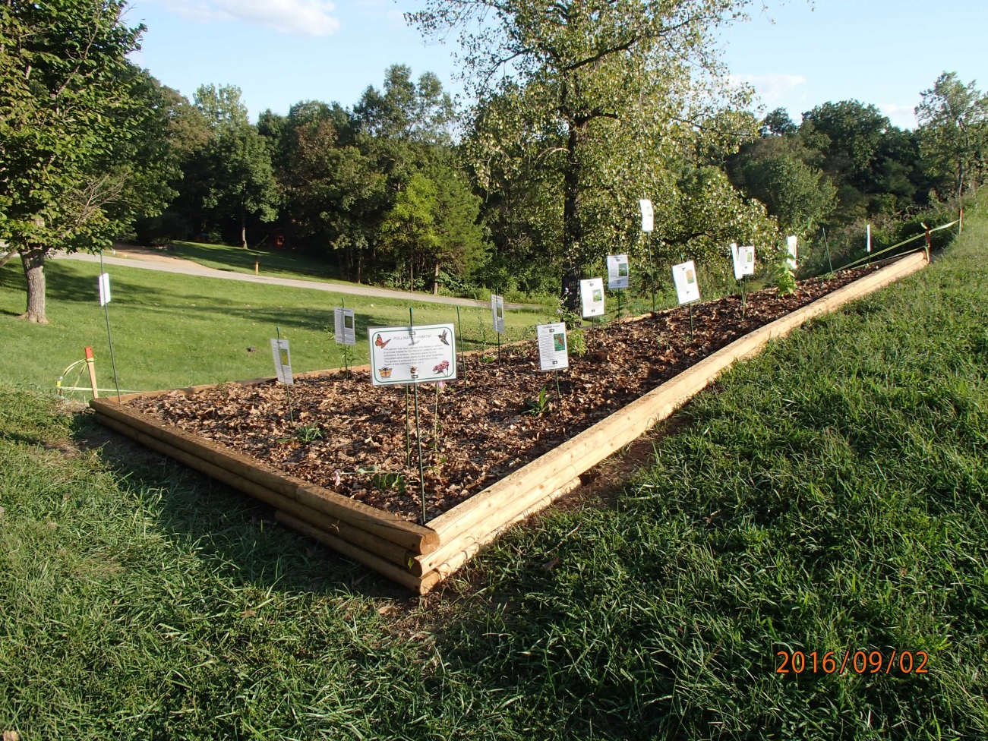
Demo Garden with ID signs

Slide 7
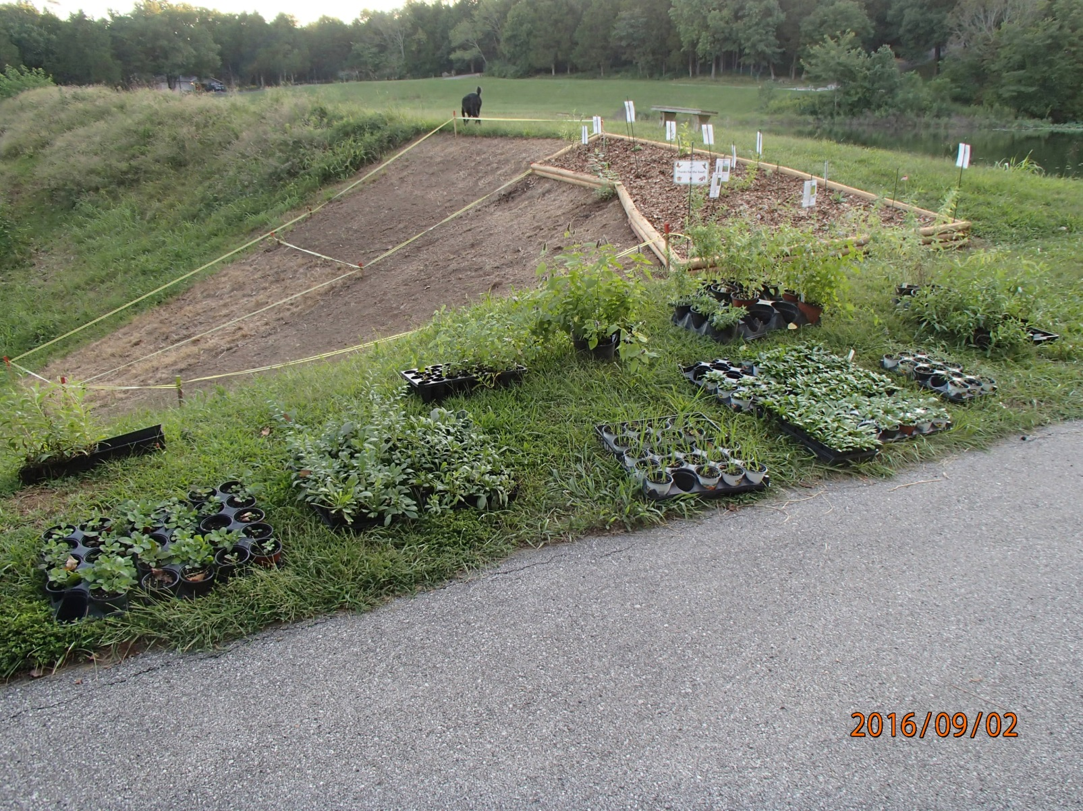
About 300 plants ready to be planted!

Slide 8
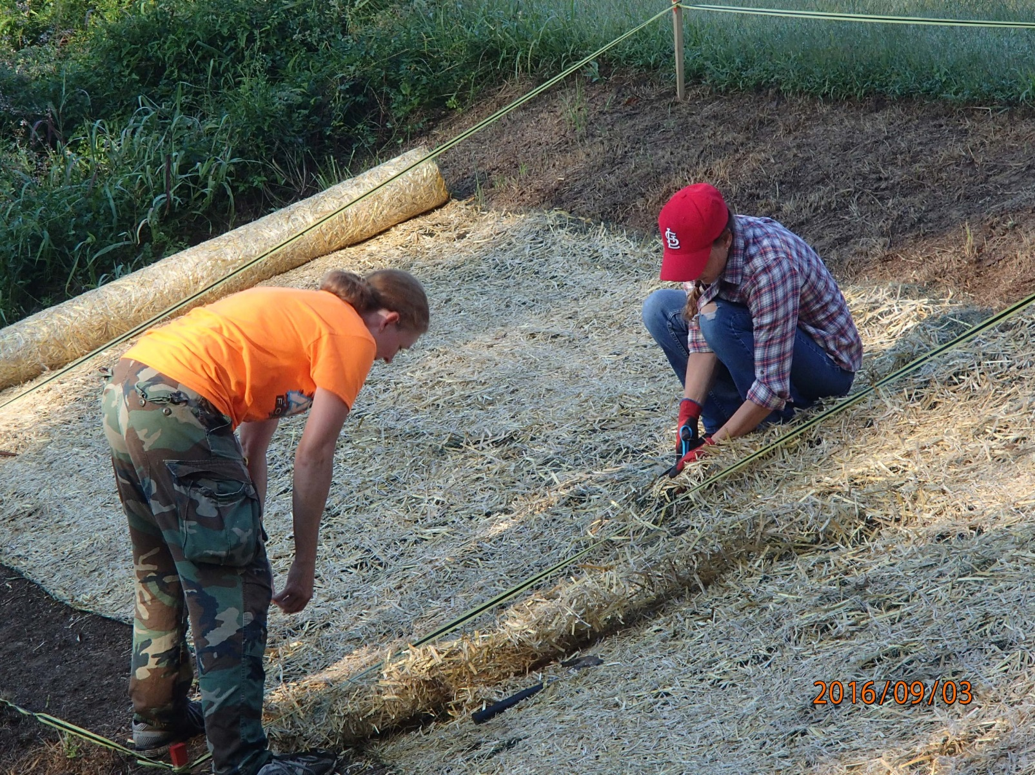
But first the erosion blanket

Slide 9
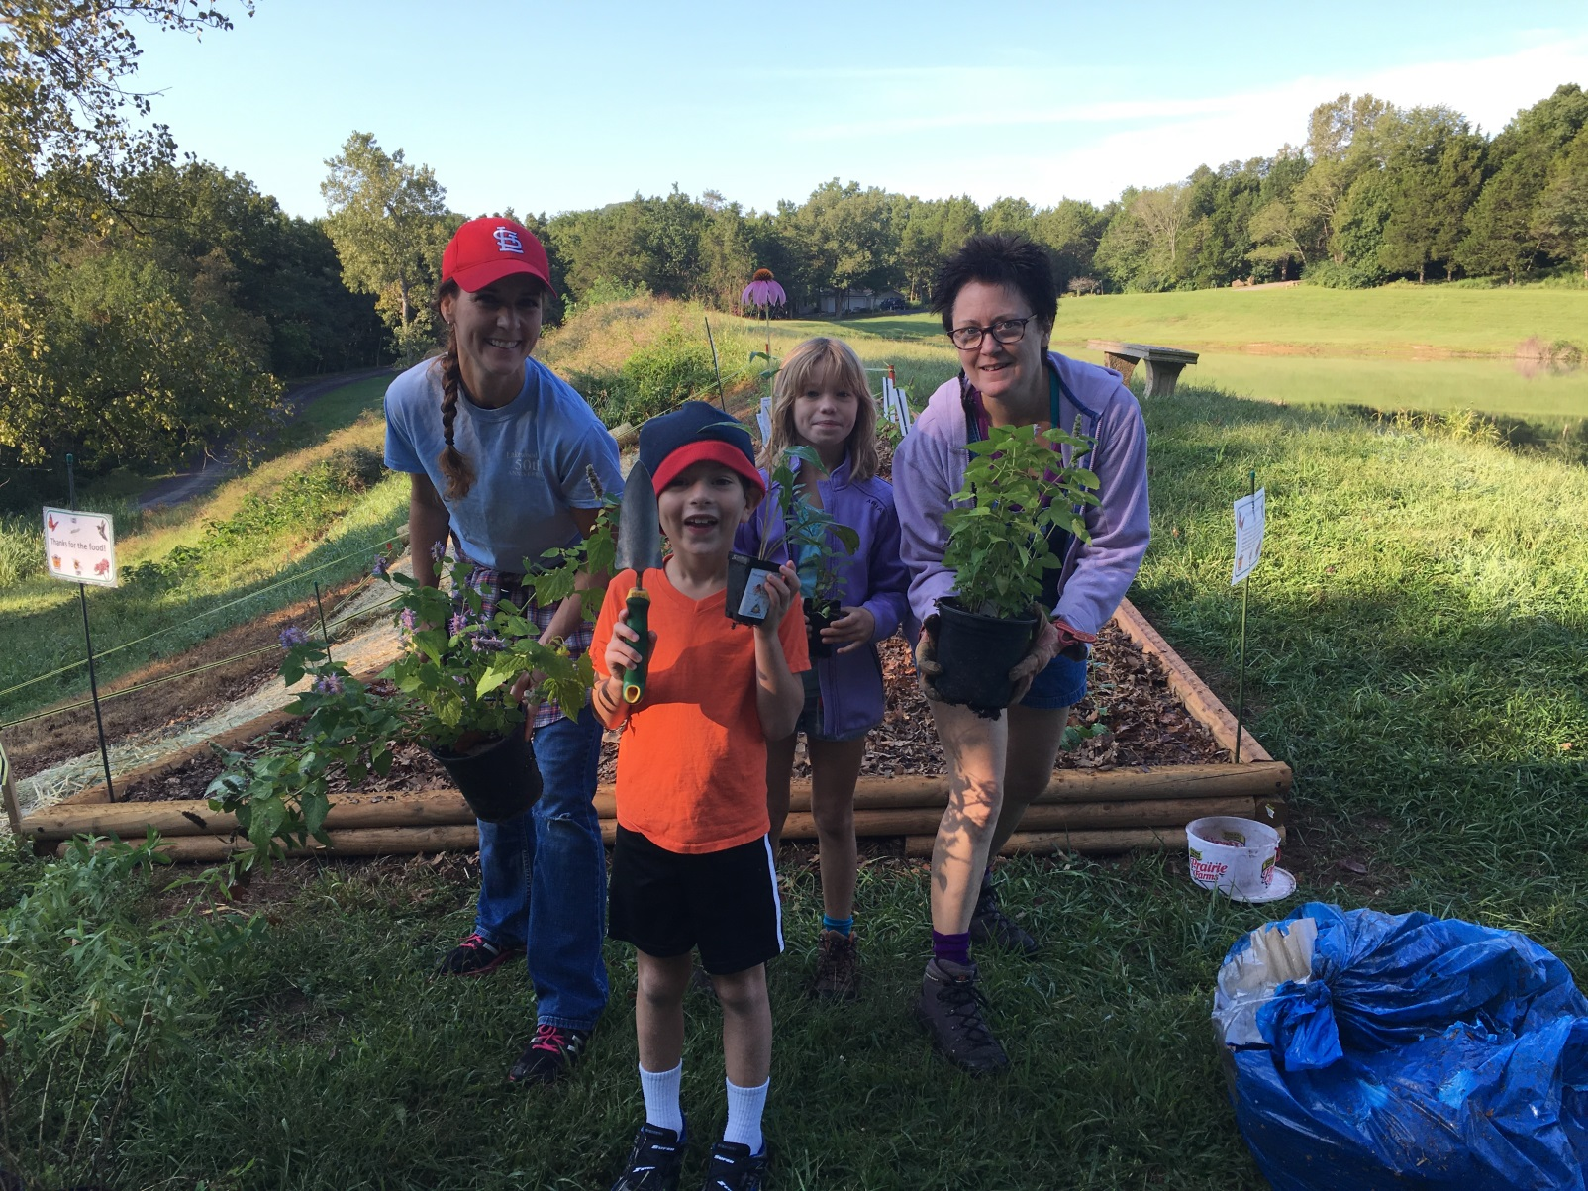
Gather a planting team and….

Slide 10
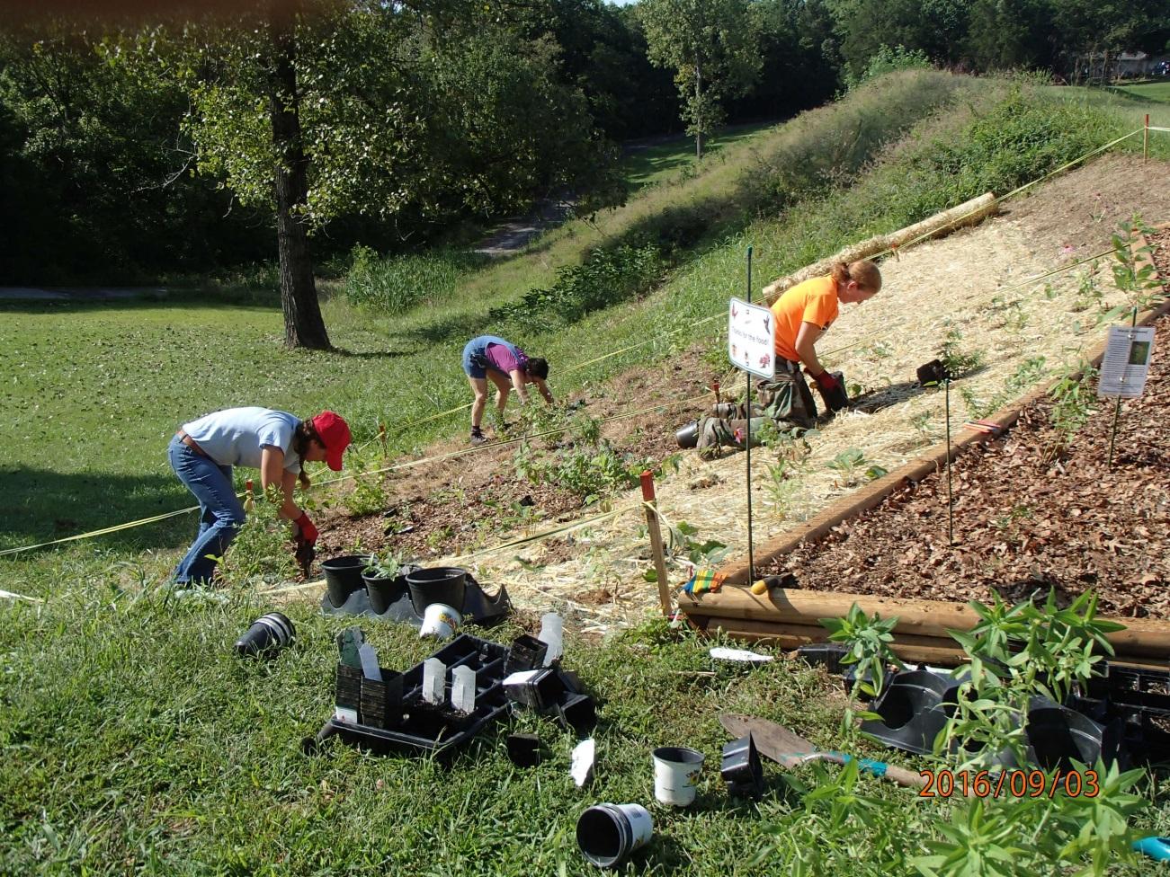
And just add plants!

Slide 11
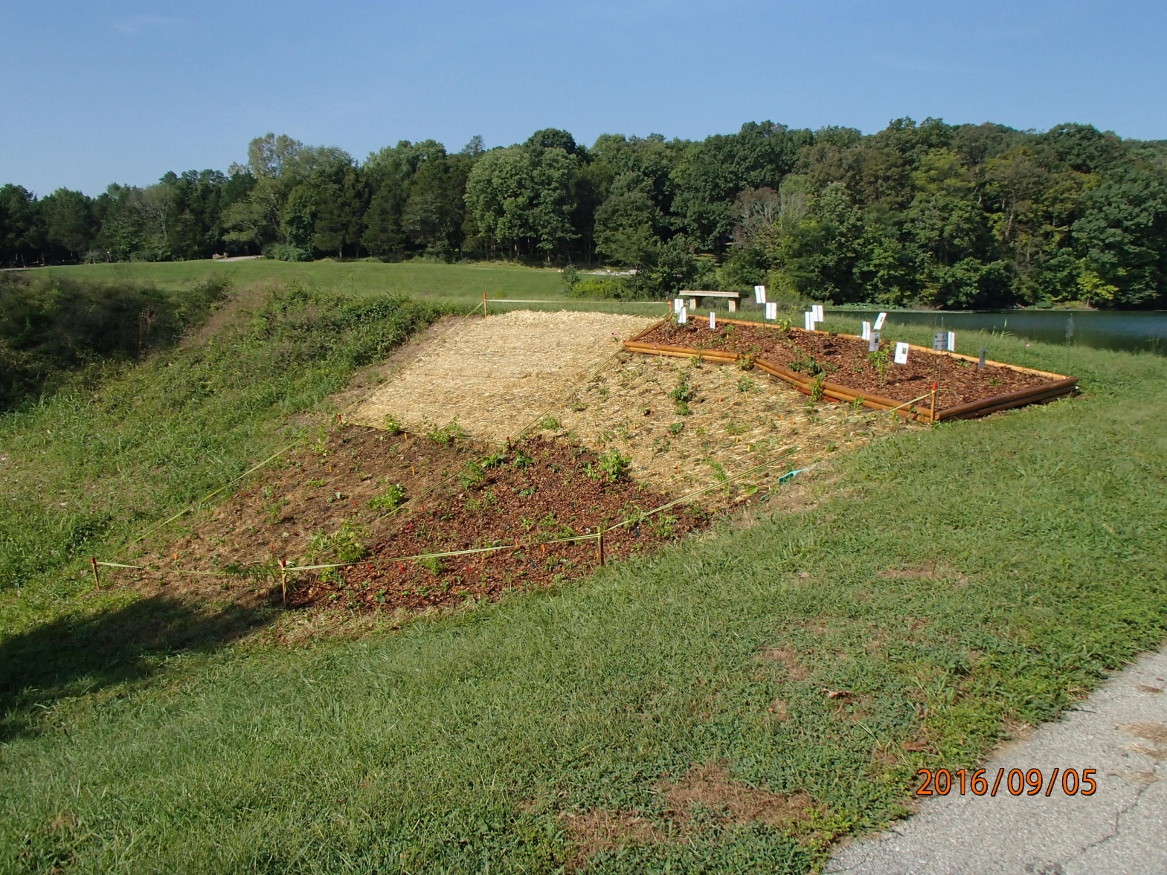
Add some leaf mulch and WOW!

Slide 12
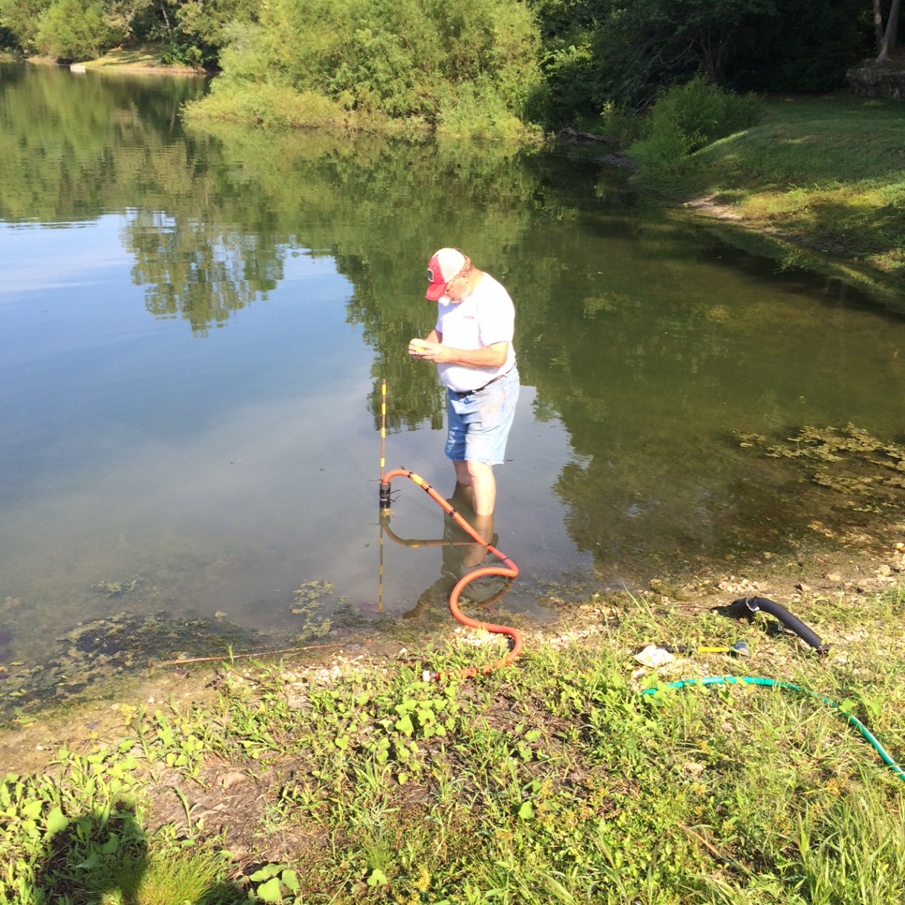
But they need water cause it is summer.

Slide 13
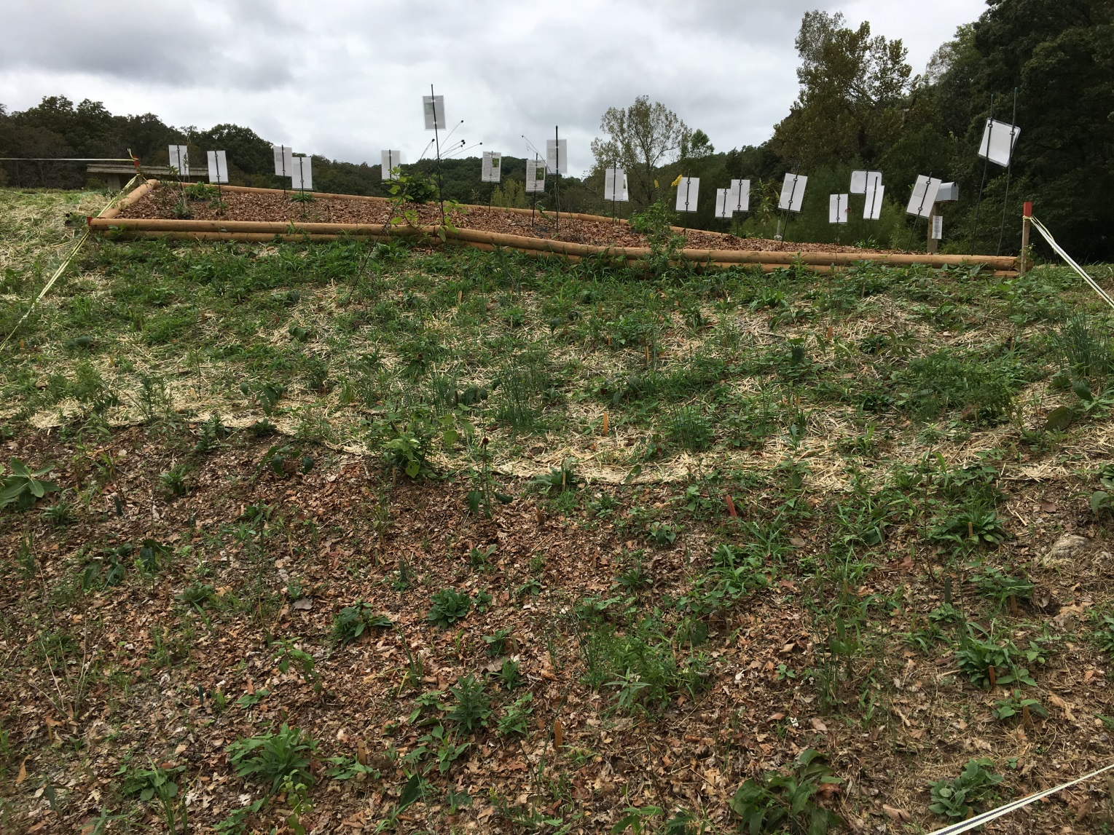
By October the plants looks really great, but the grass is coming back!

Slide 14
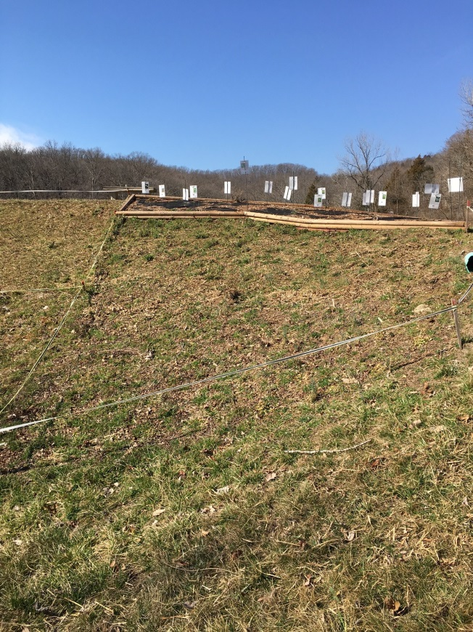
In February, removed the erosion blanket.

Slide 15
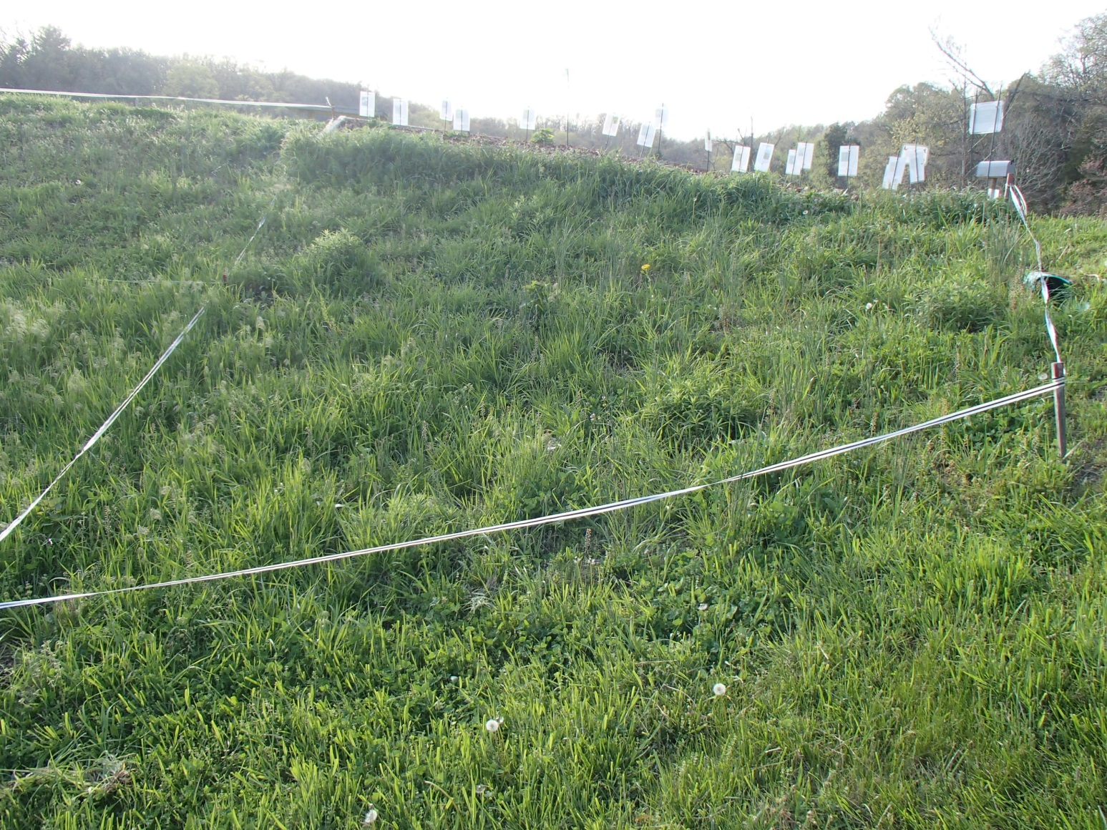
And by spring – LOTS of grass!

Slide 16
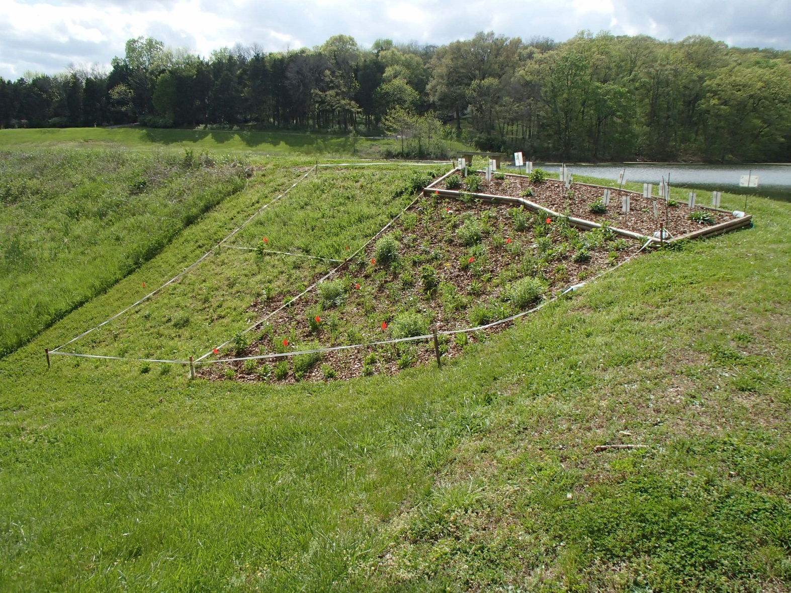
No worries – just needs a haircut and some more leaf mulch.

Slide 17
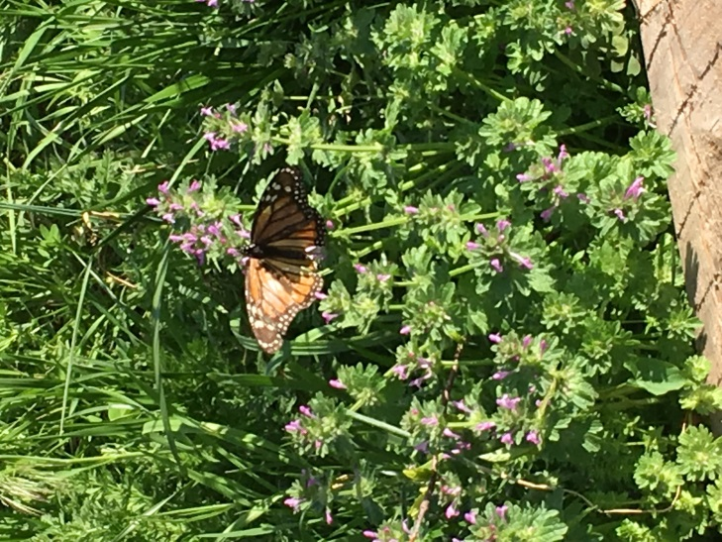
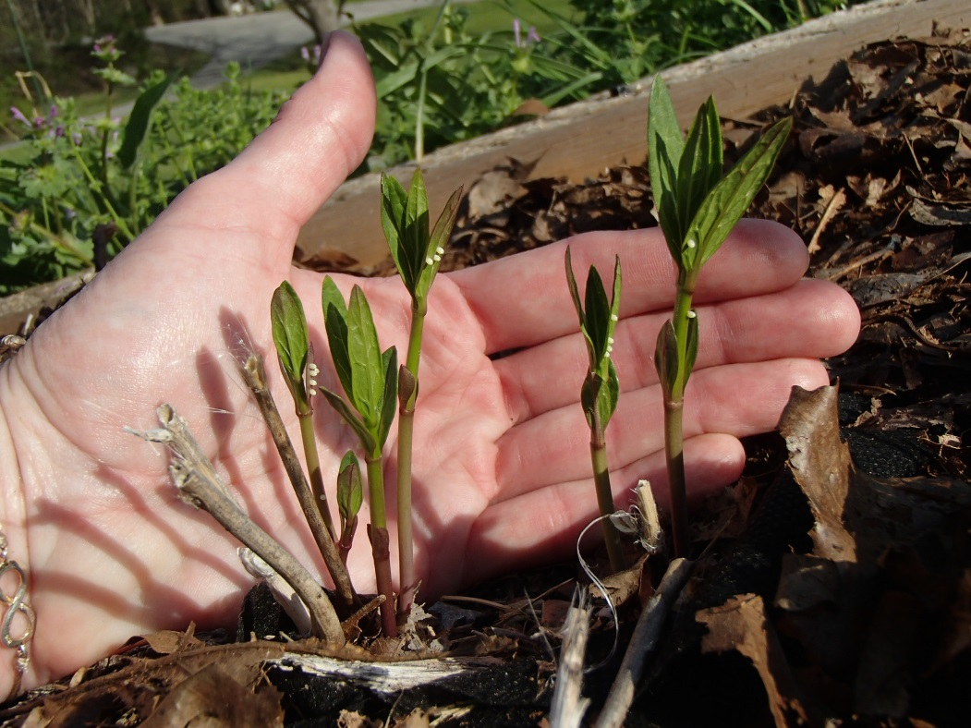
If you build it, they will come.

