Slide 1
Gem Lake Reconstruction Completed!!

Slide 2
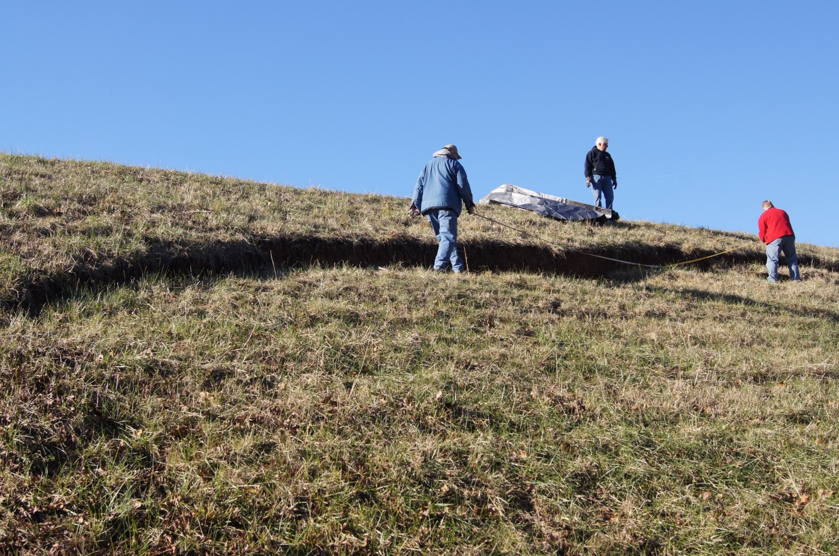

Slide 3
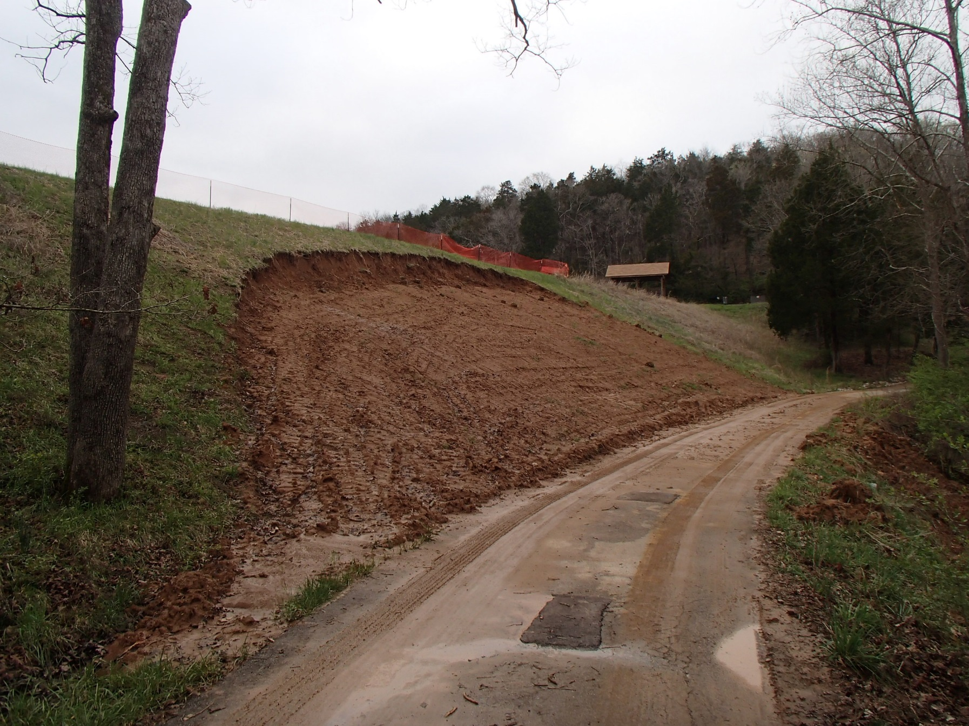

Slide 4
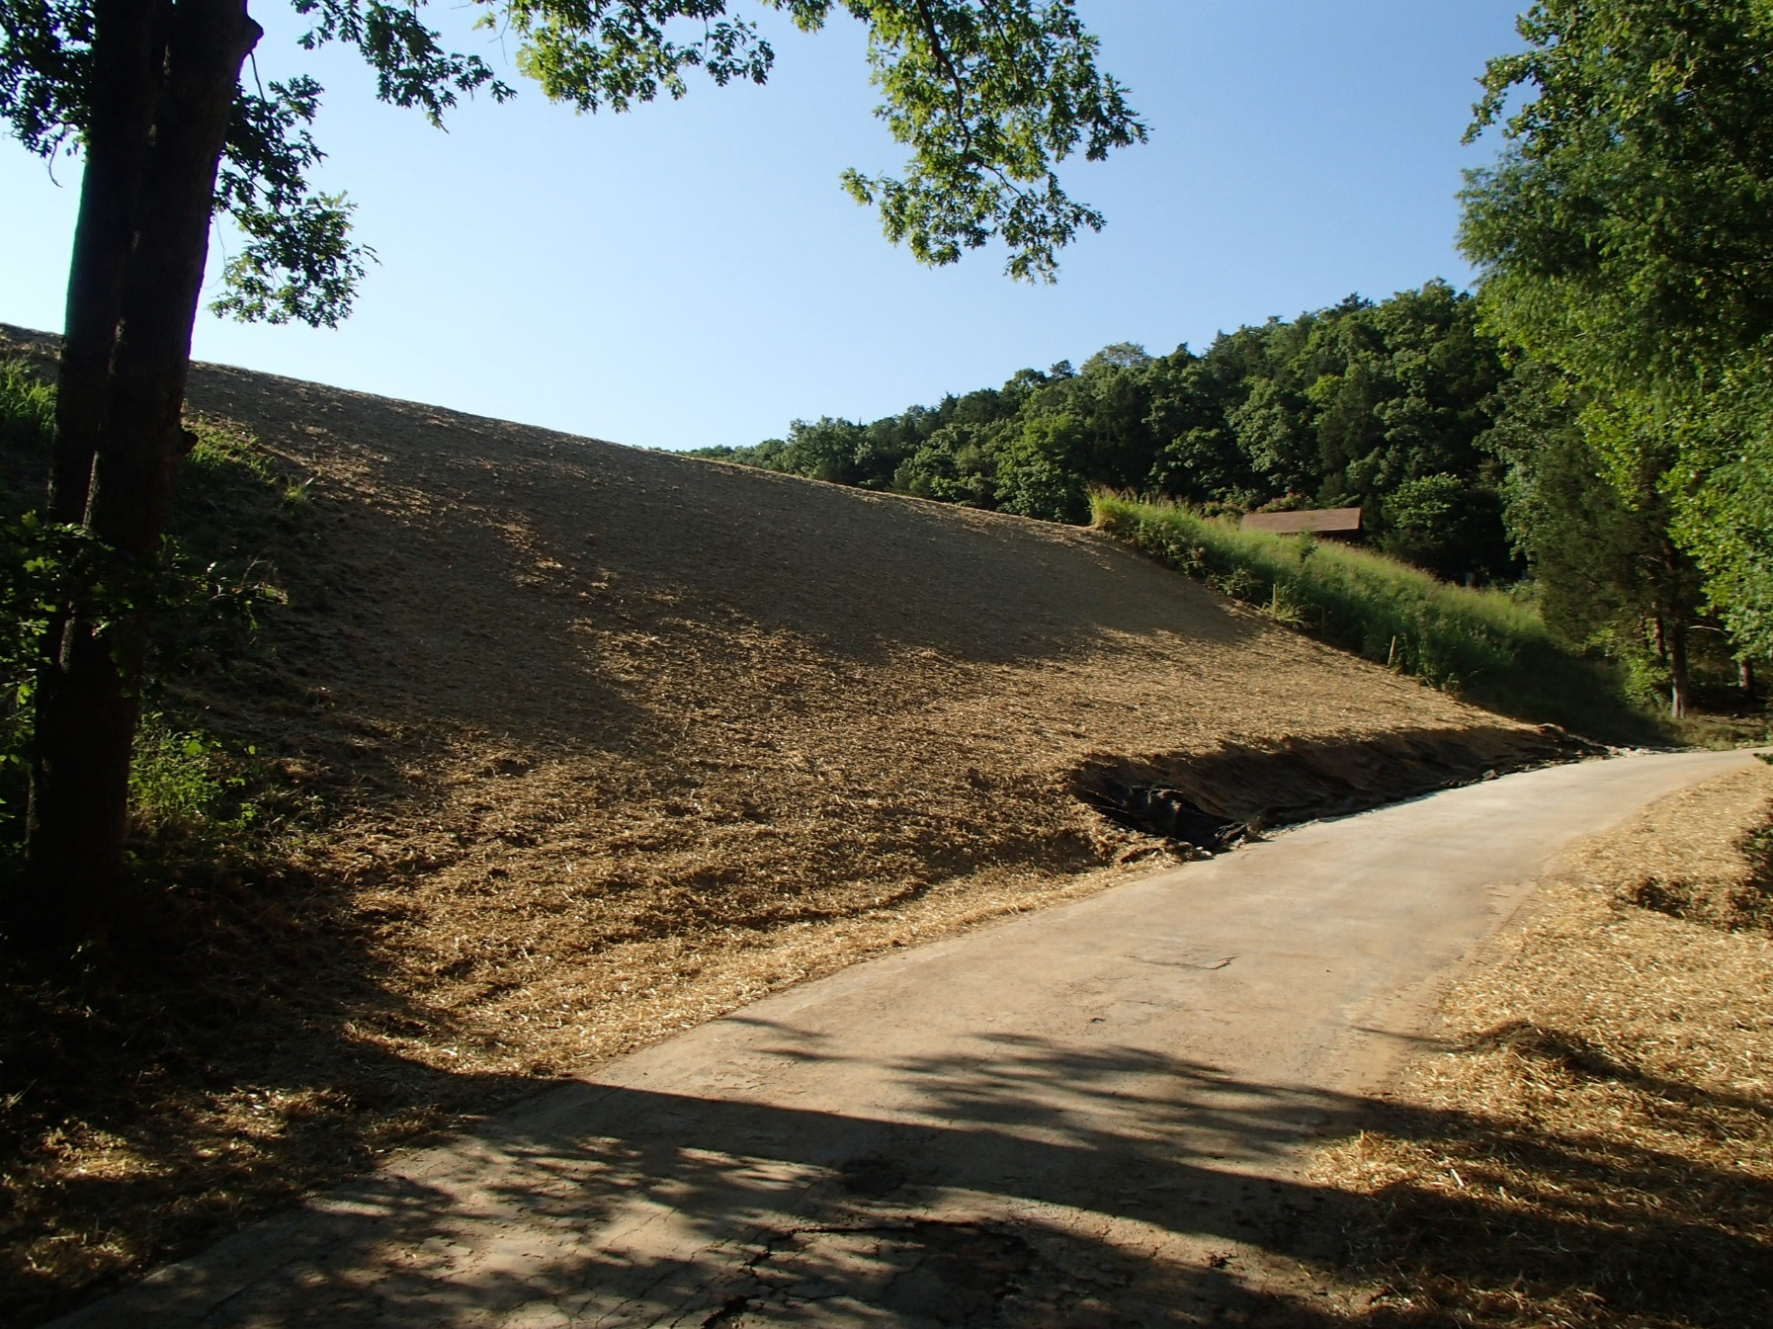

Slide 5
Water Level – working its
way up

Slide 6
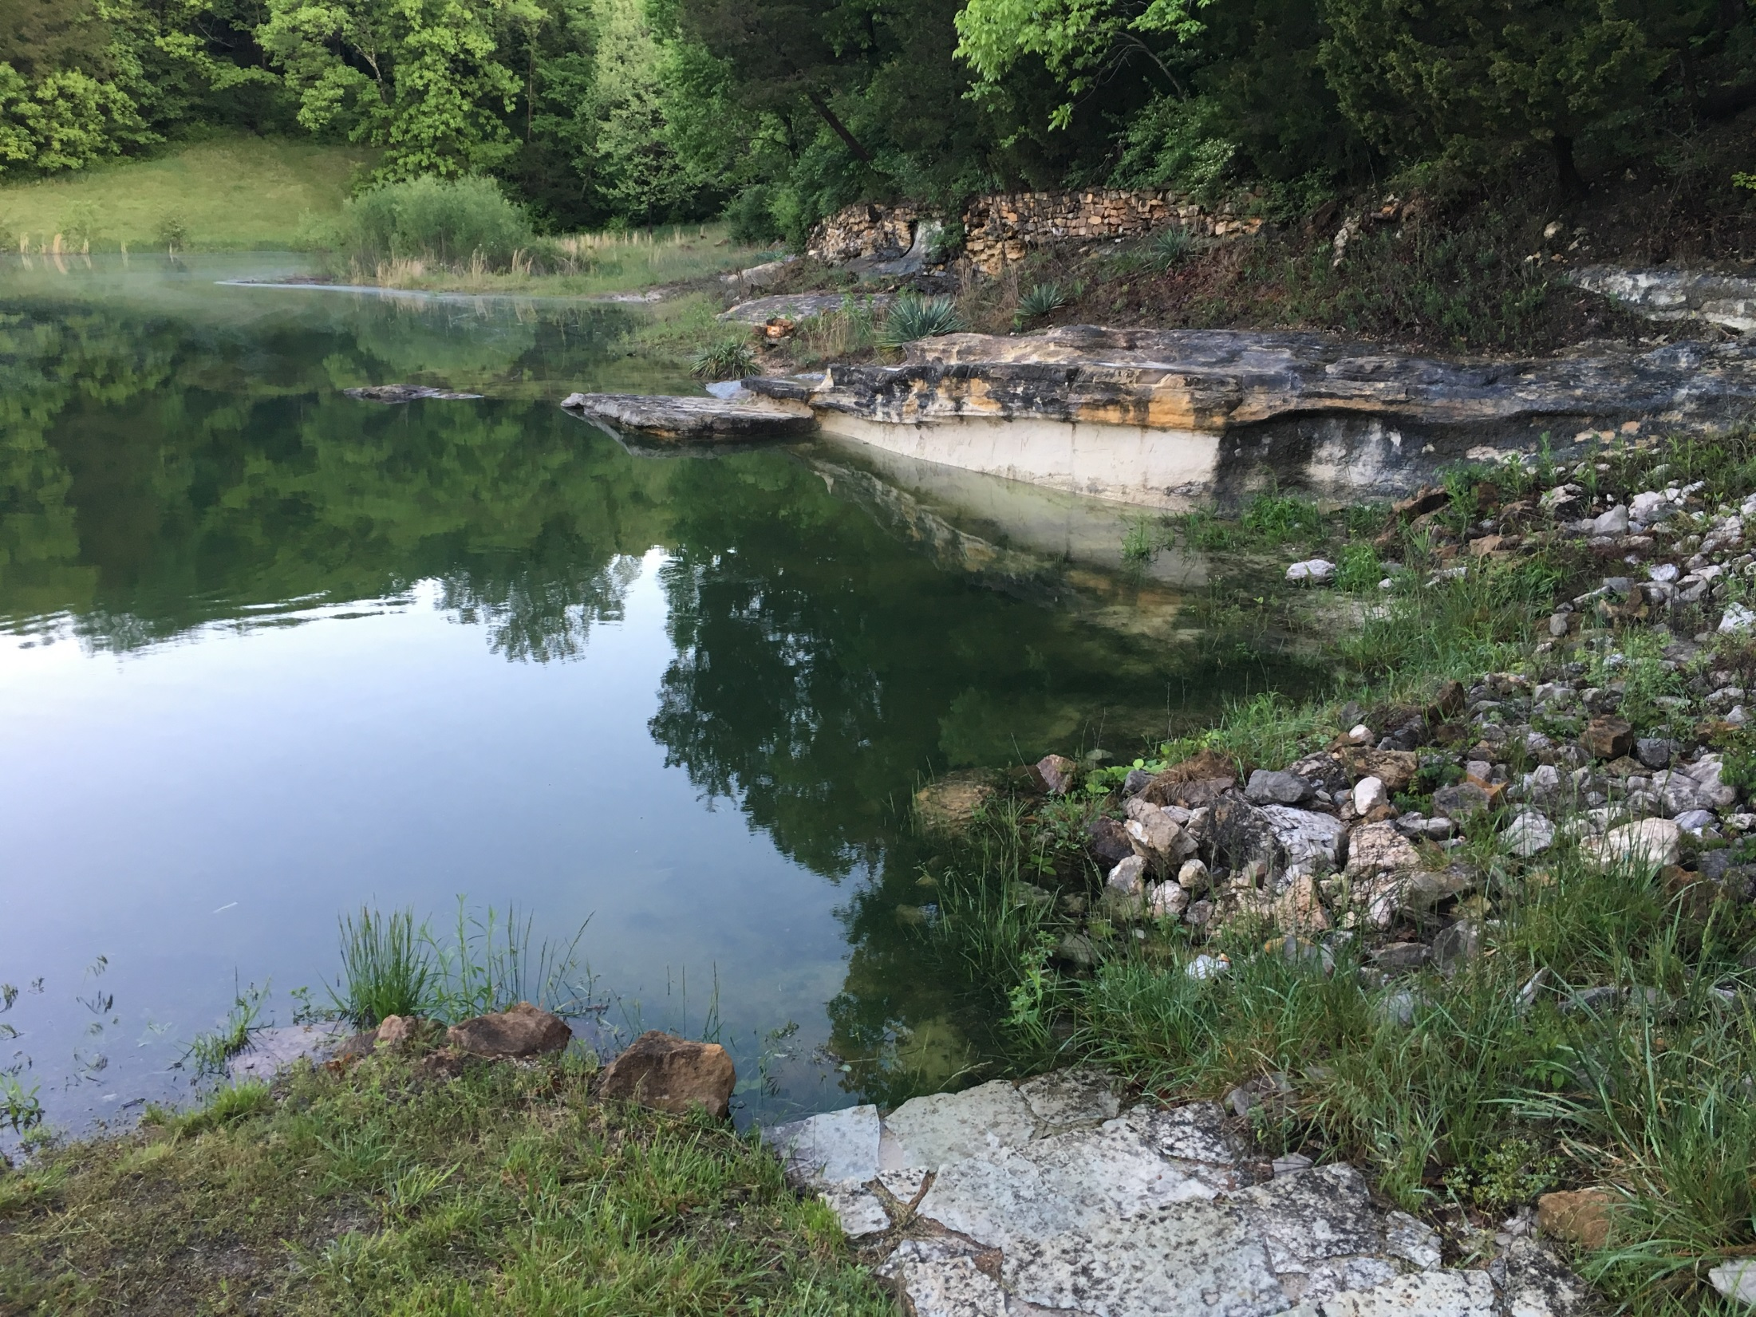
Spring 2017

Slide 7
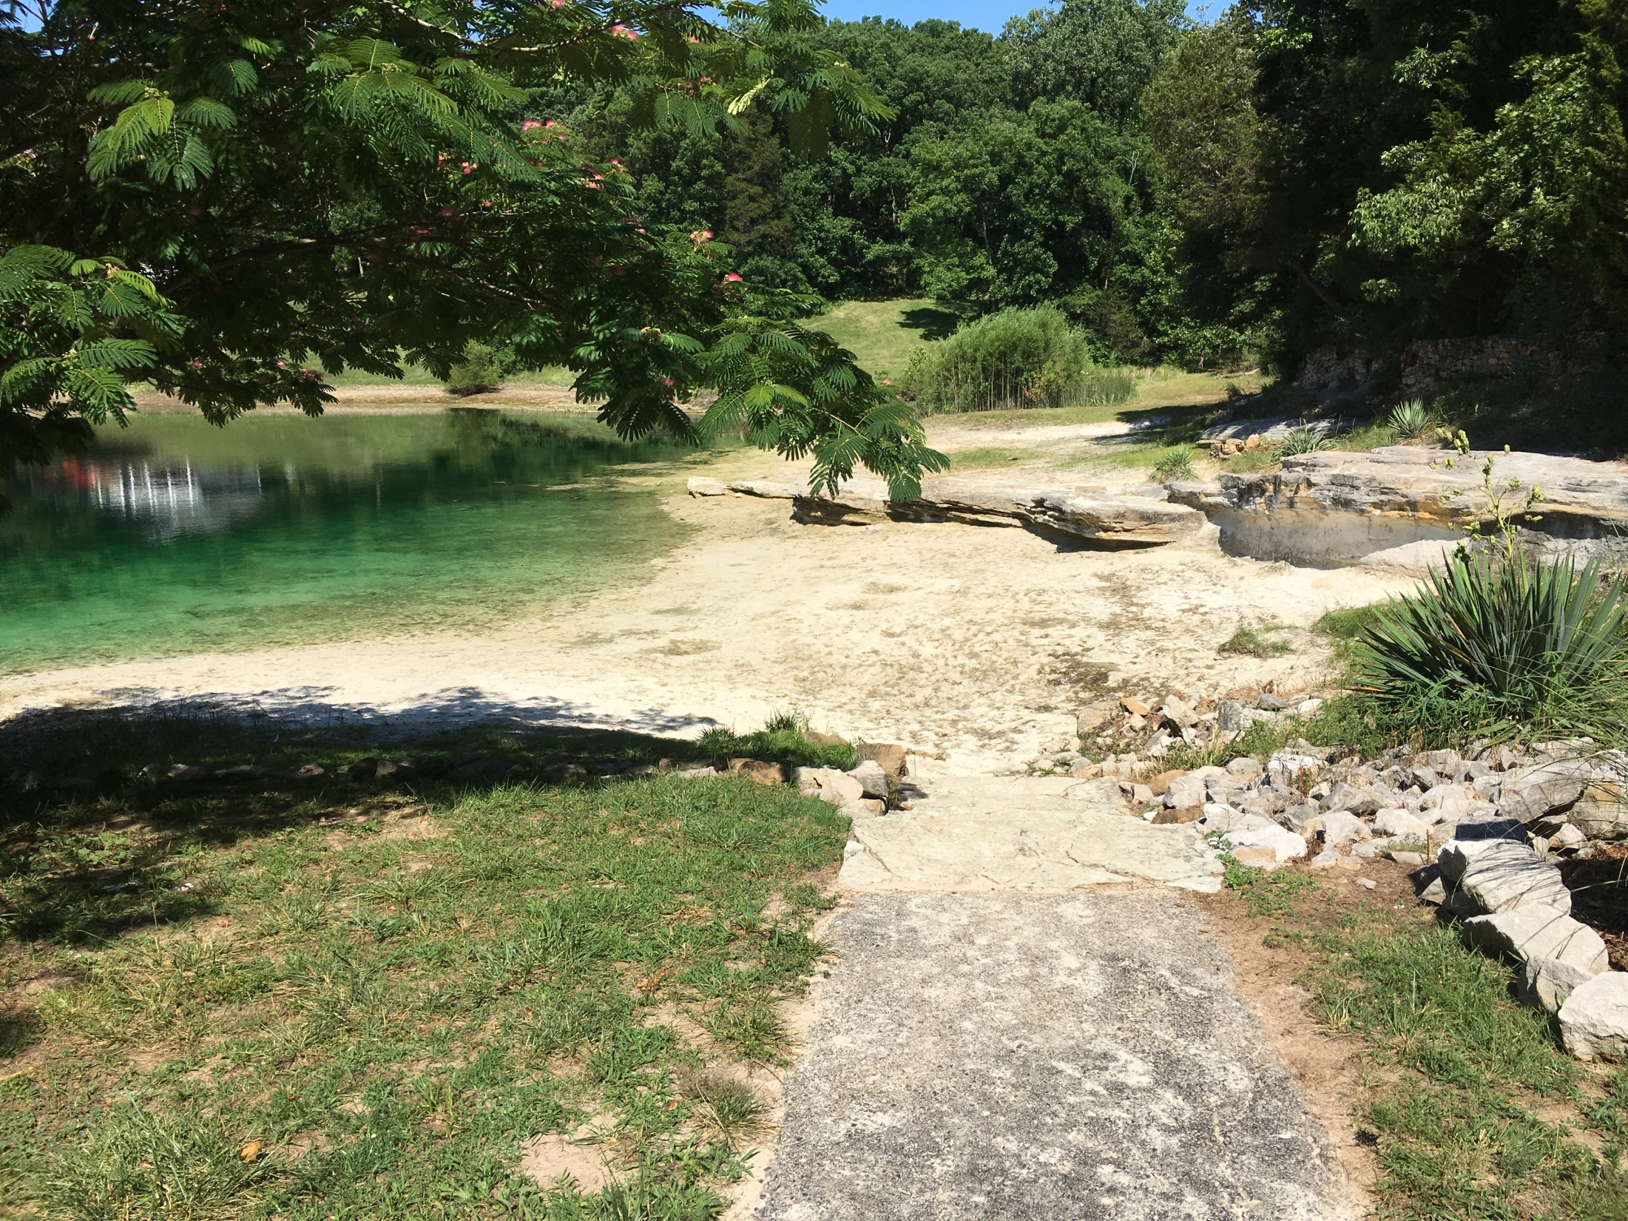
After draining.

Slide 8
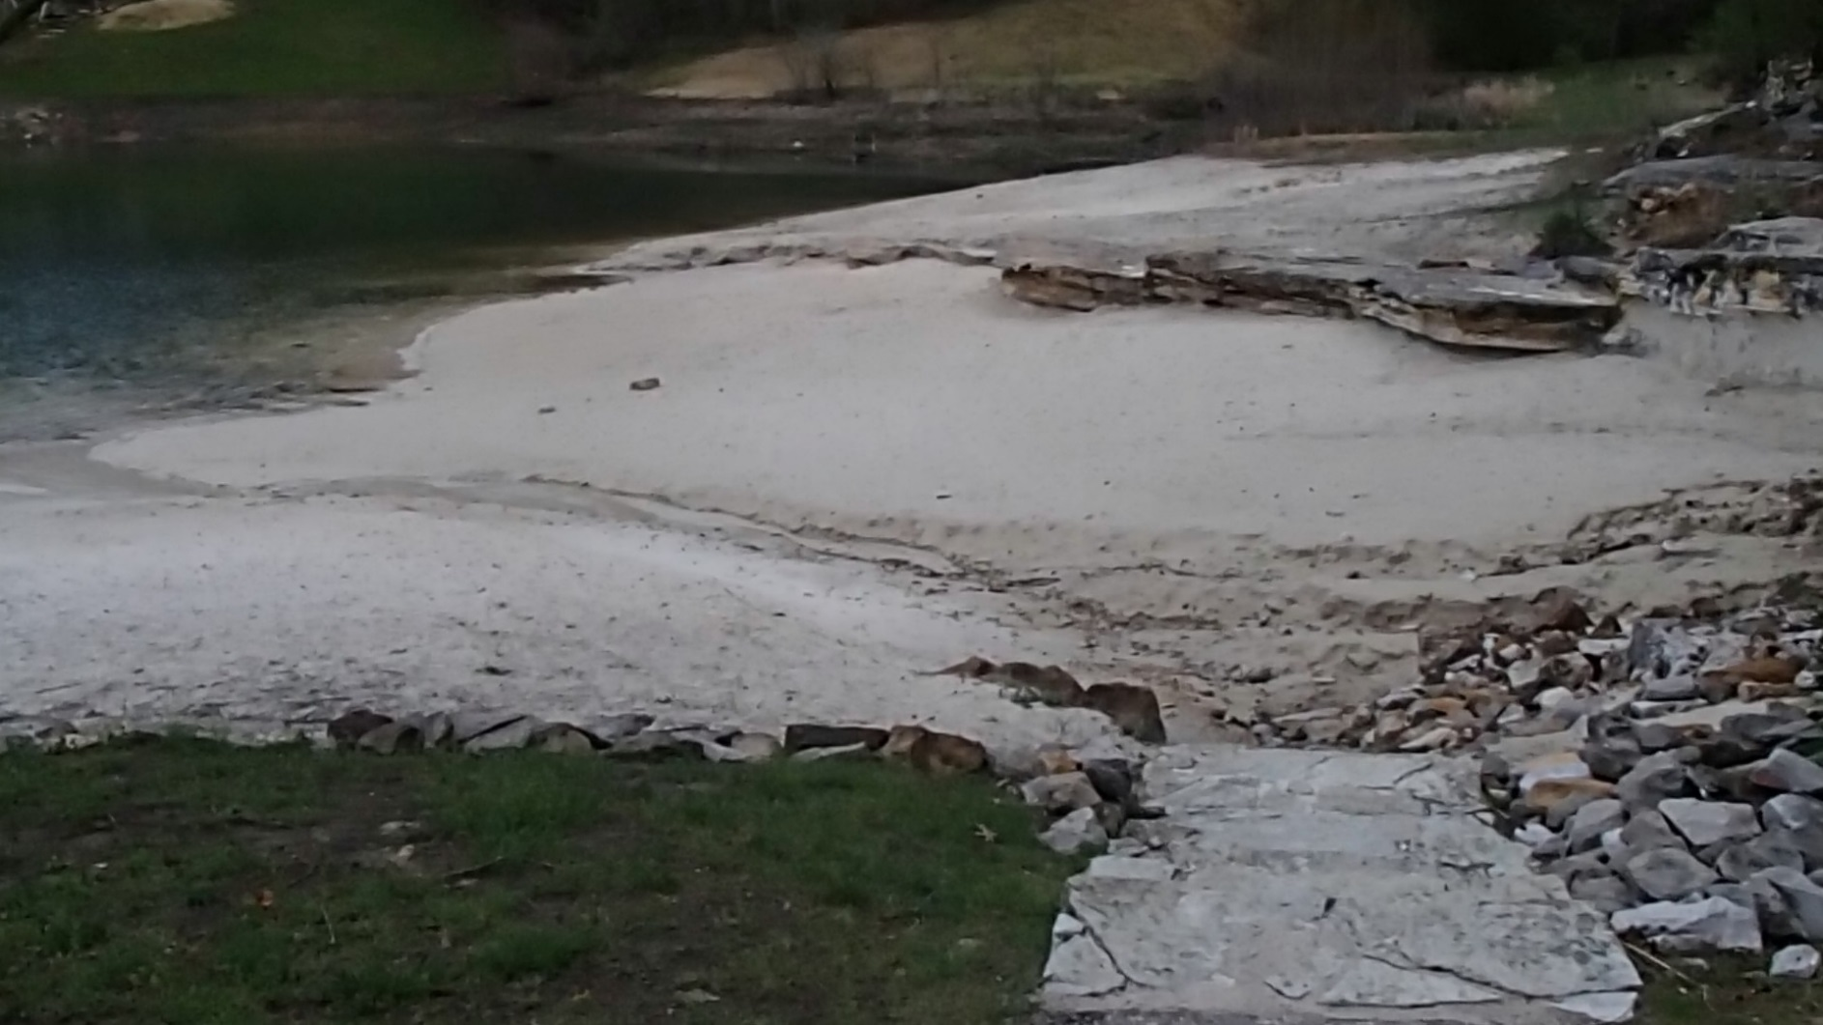
Current photo

Slide 9
Then in March we BURNED!
On March 10th, a crew of fantastic volunteers came out to help burn away the vegetation on both lake dams as part of the management recommendation from the Department of Natural Resources.
And what great day we had!

Slide 10
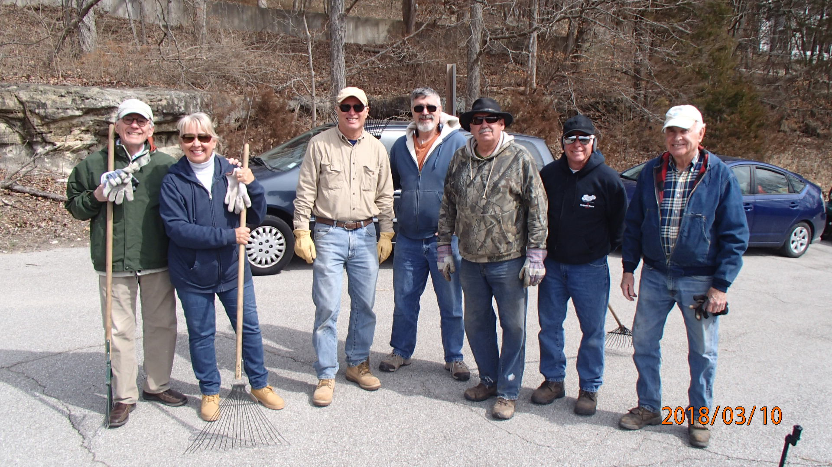
The Crew

Slide 11
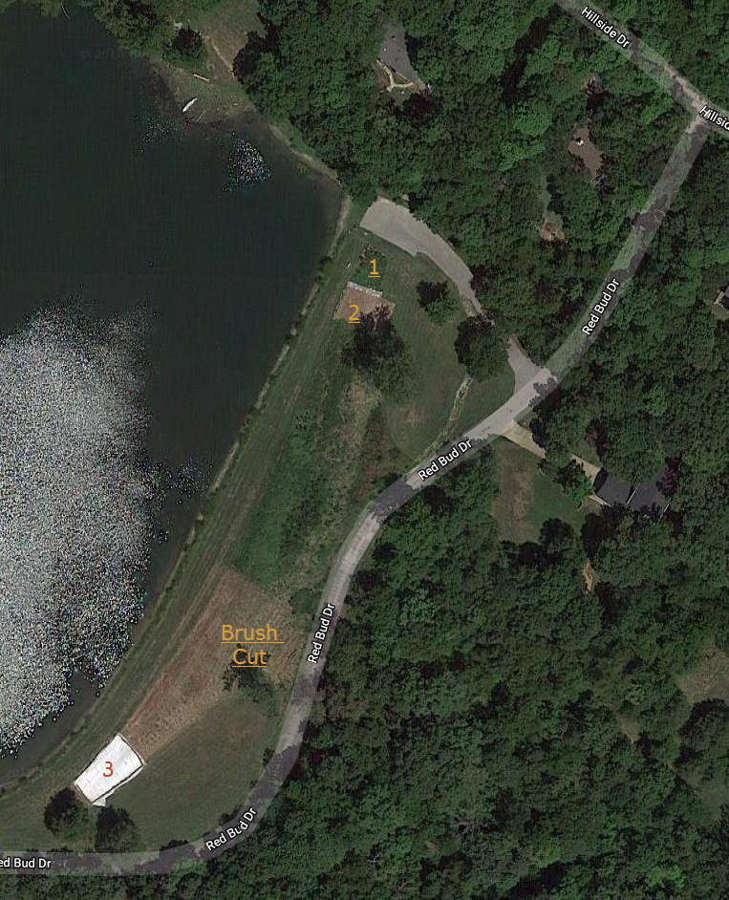
Crystal
Lake

Slide 12
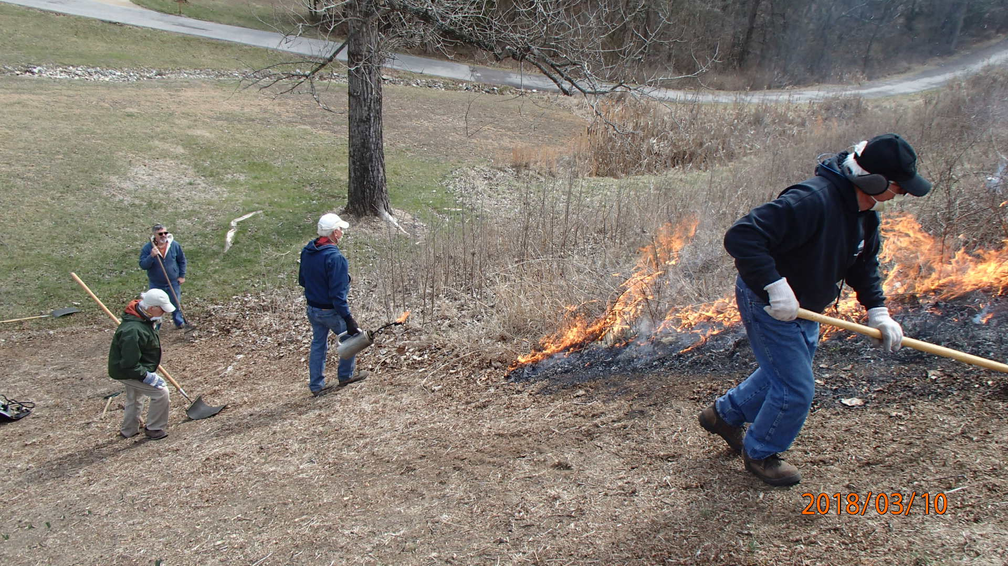

Slide 13
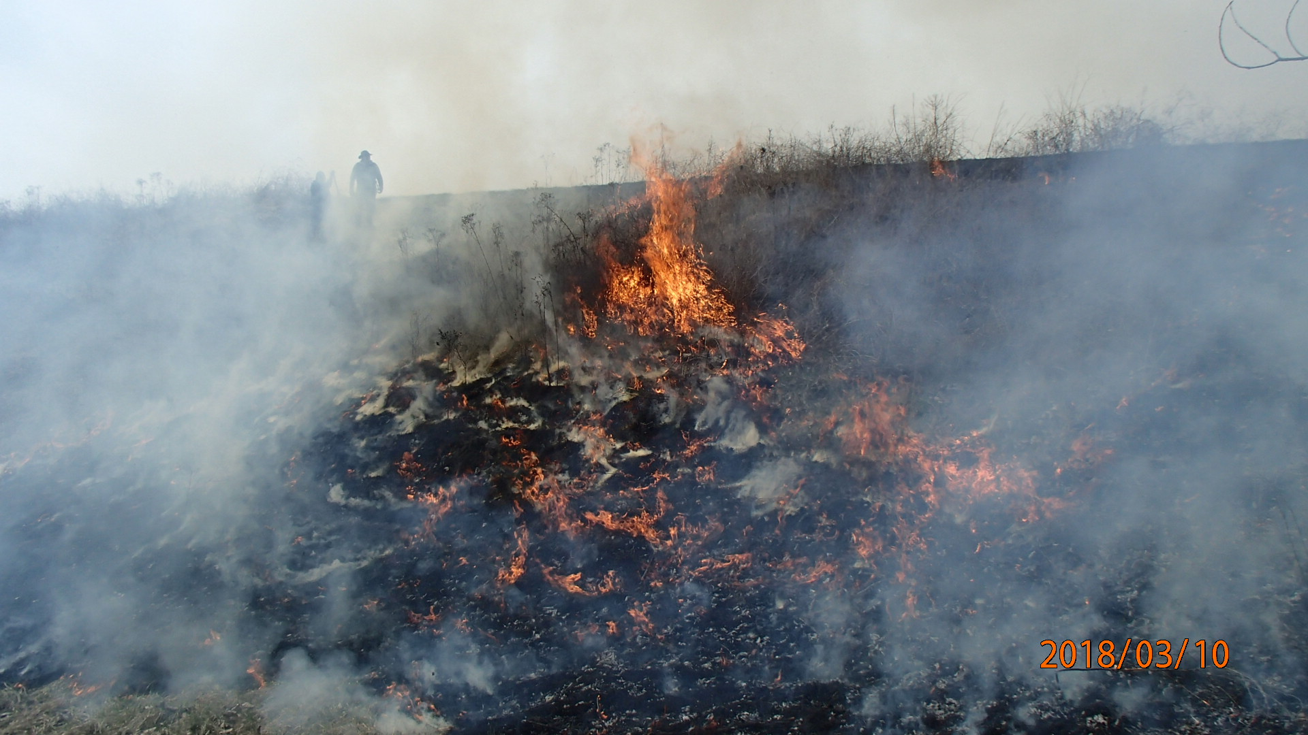

Slide 14
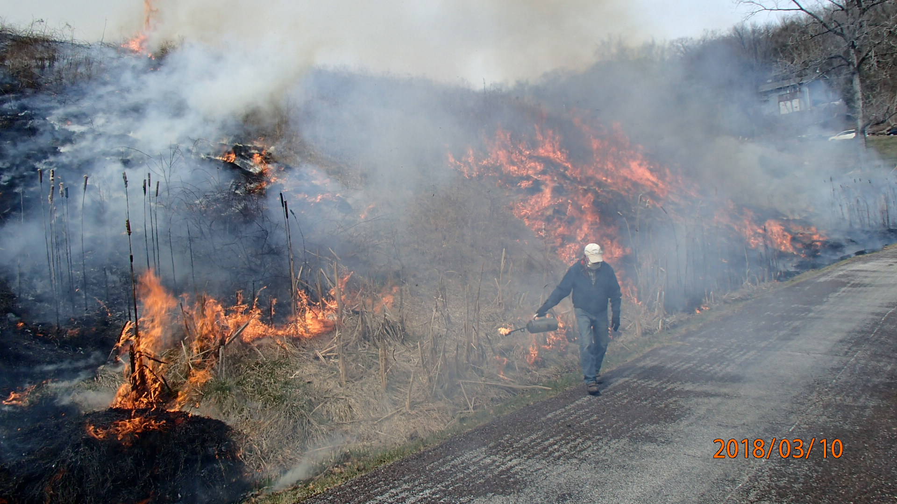

Slide 15
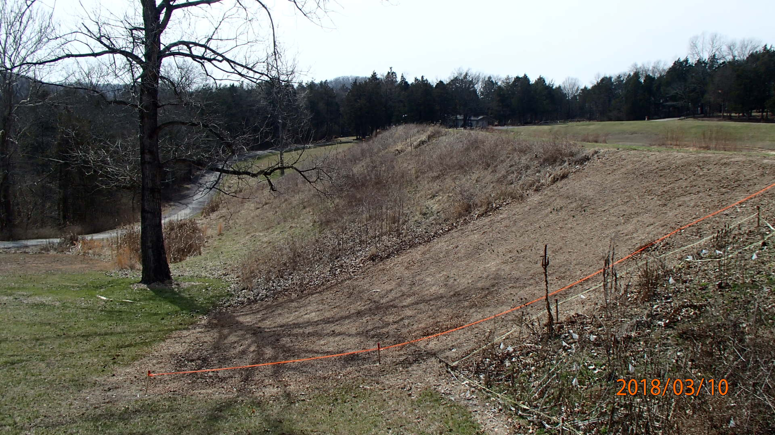
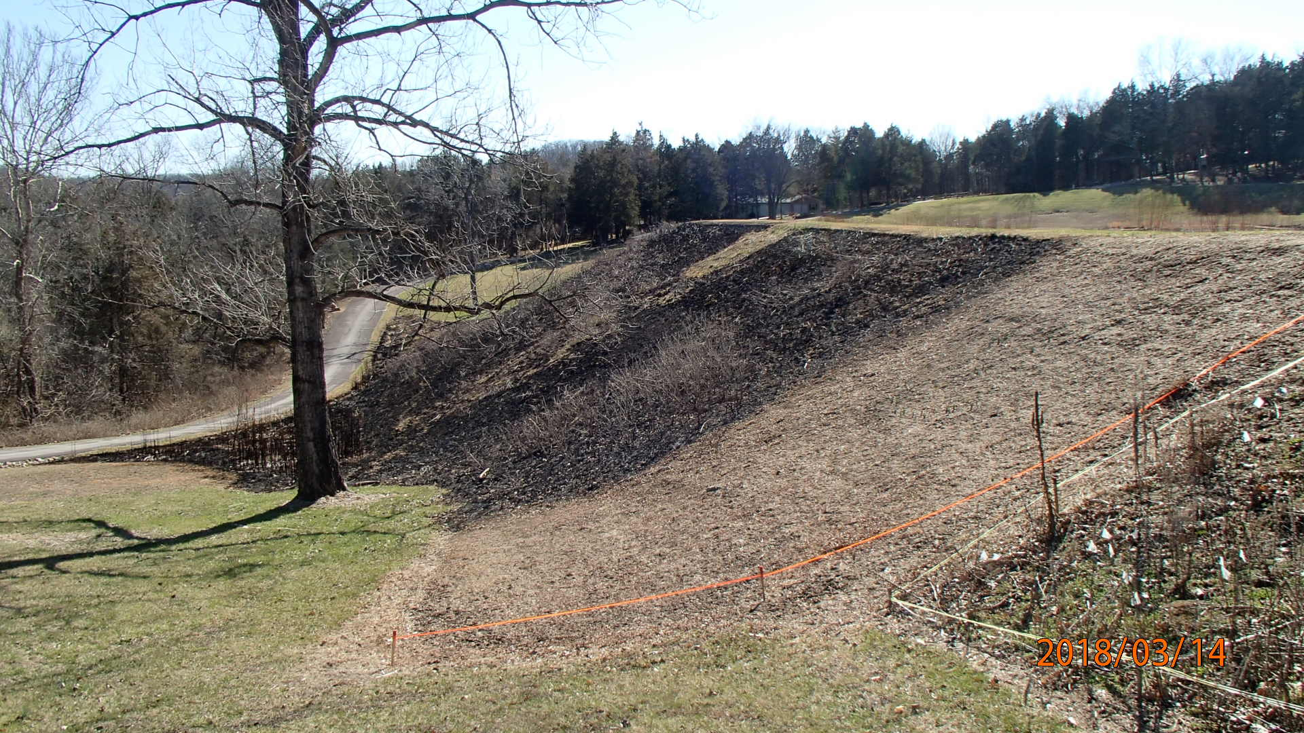

Slide 16
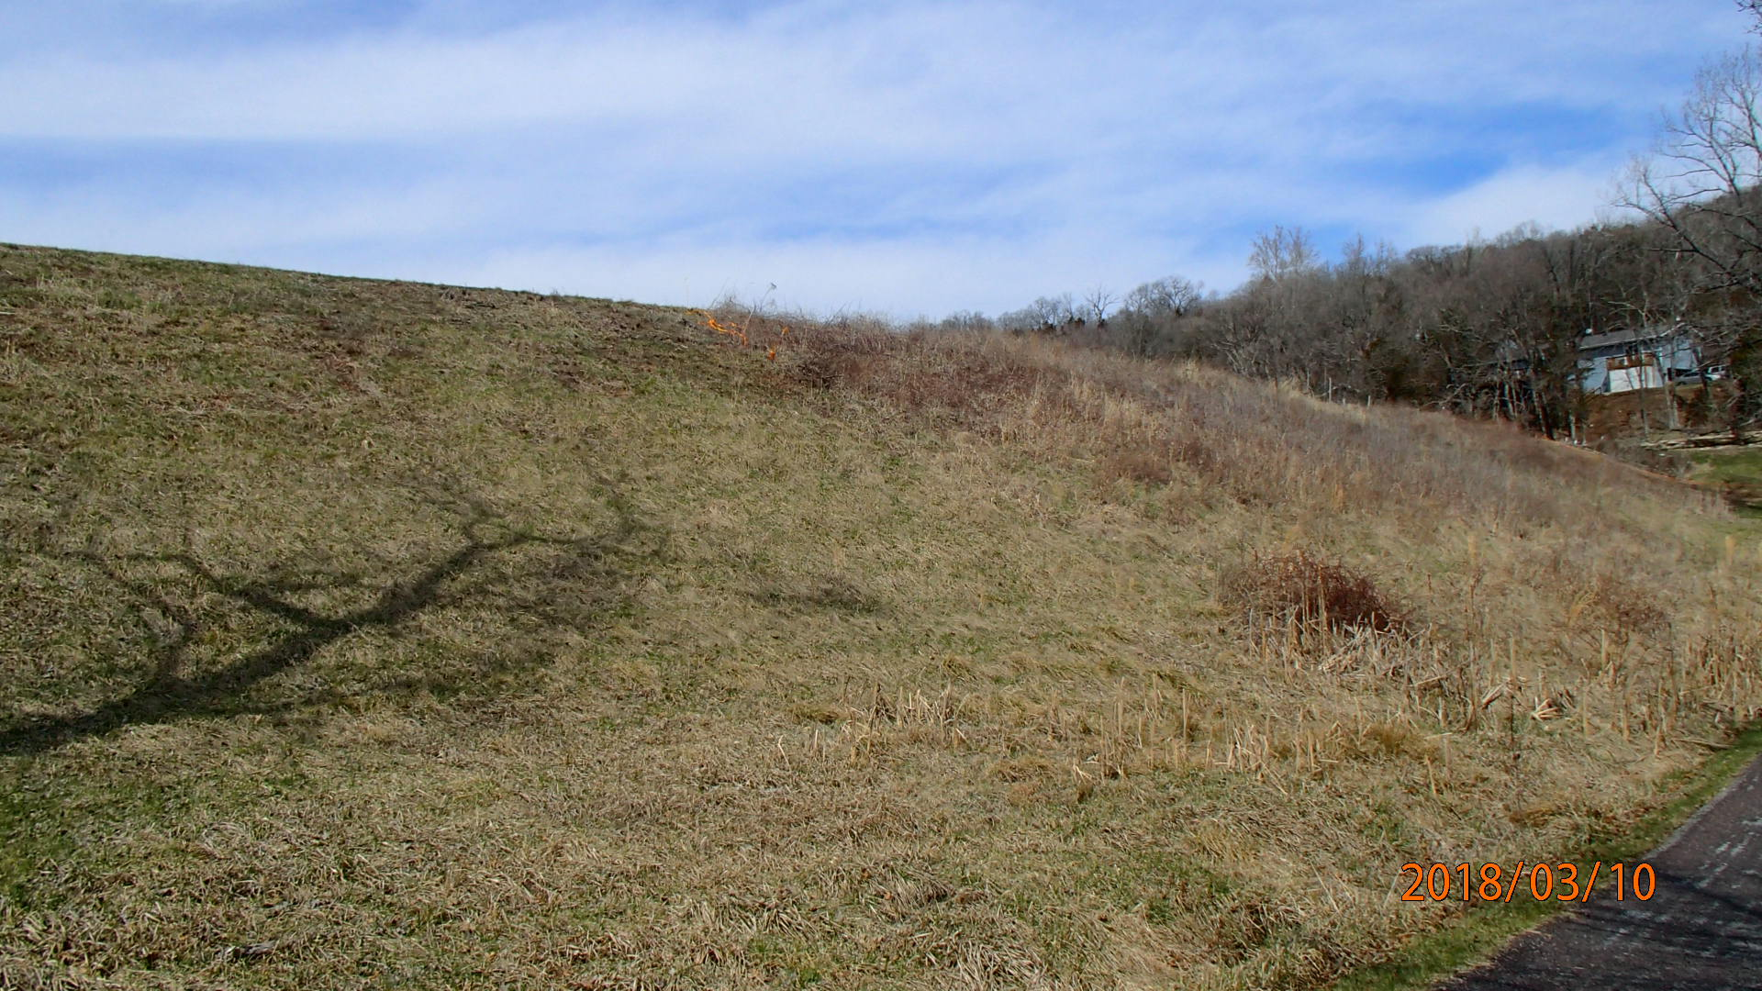
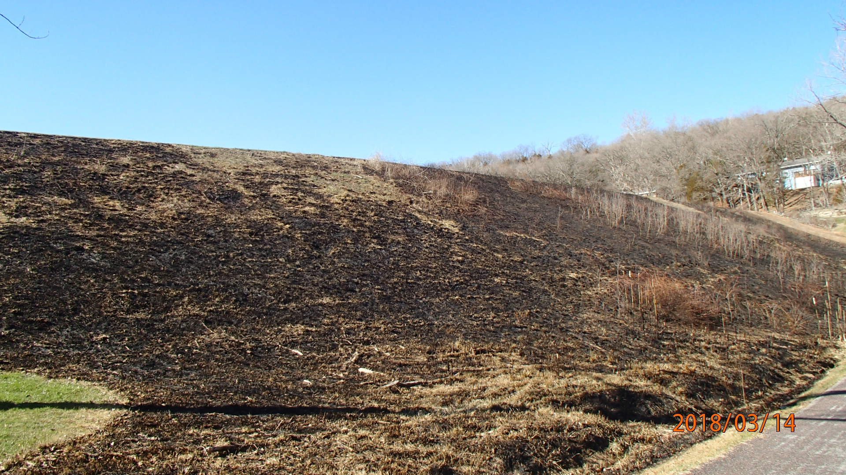

Slide 17
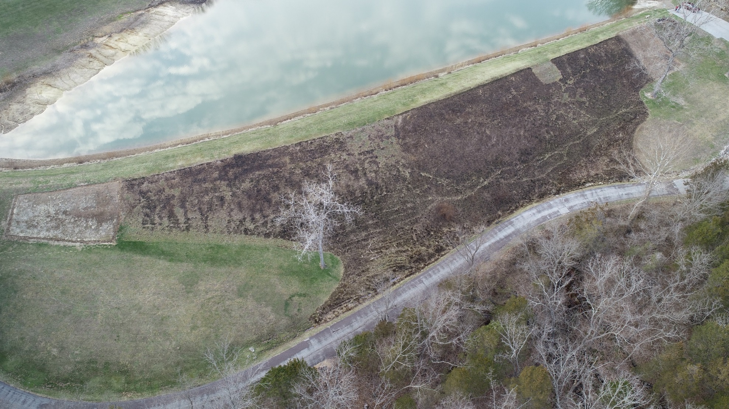

Slide 18
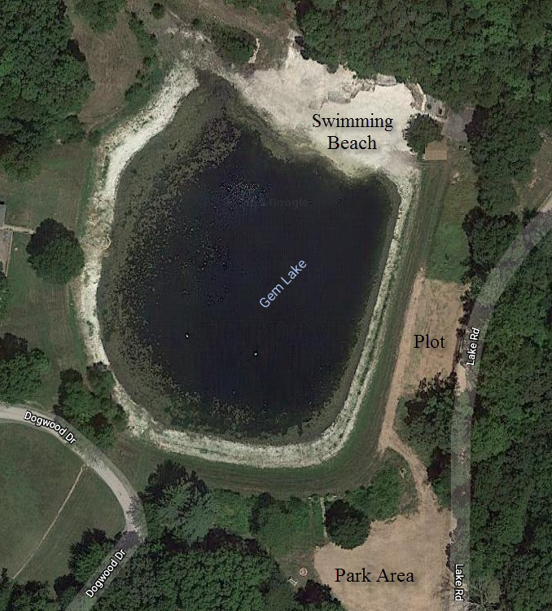
Gem
Lake

Slide 19
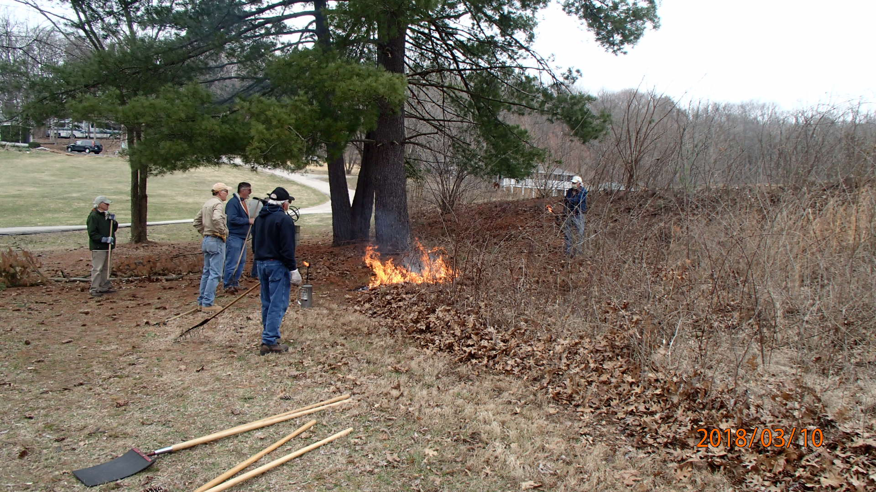

Slide 20
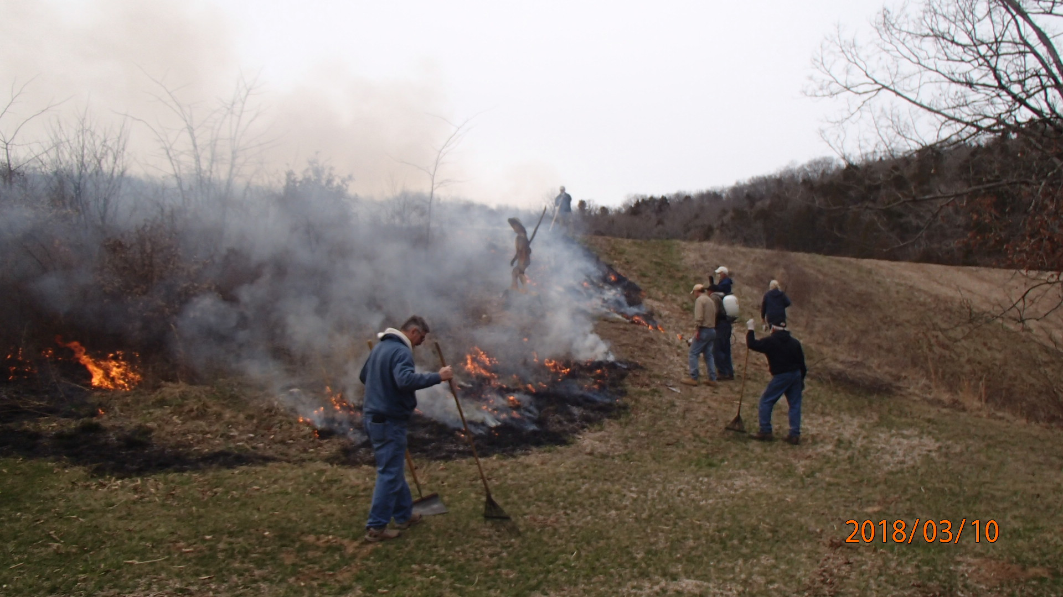

Slide 21
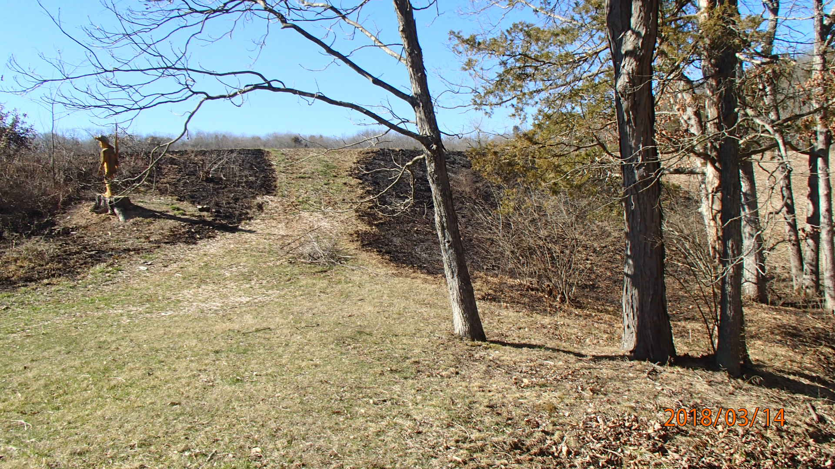

Slide 22
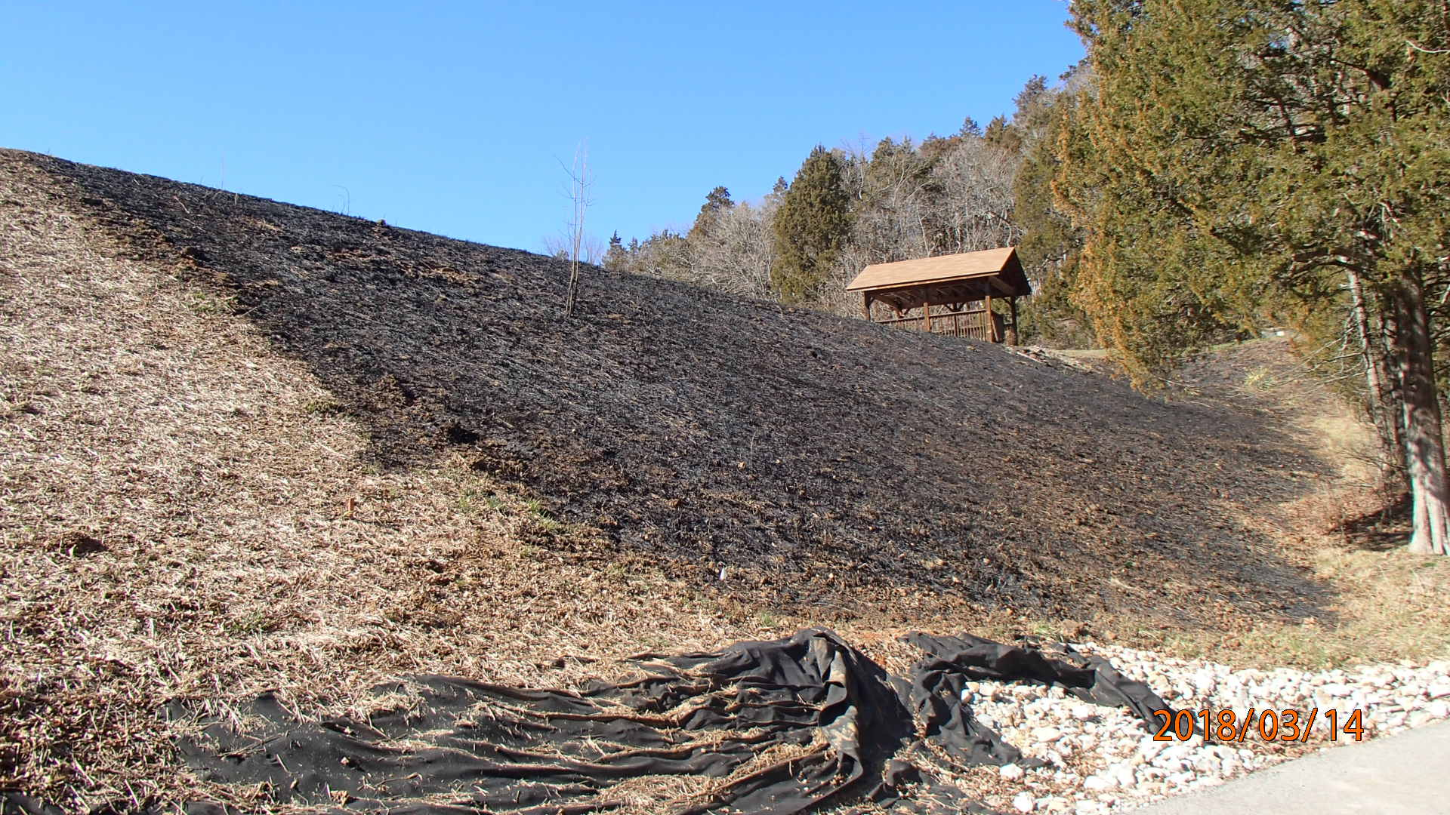
Film 1
Film 2

Slide 23
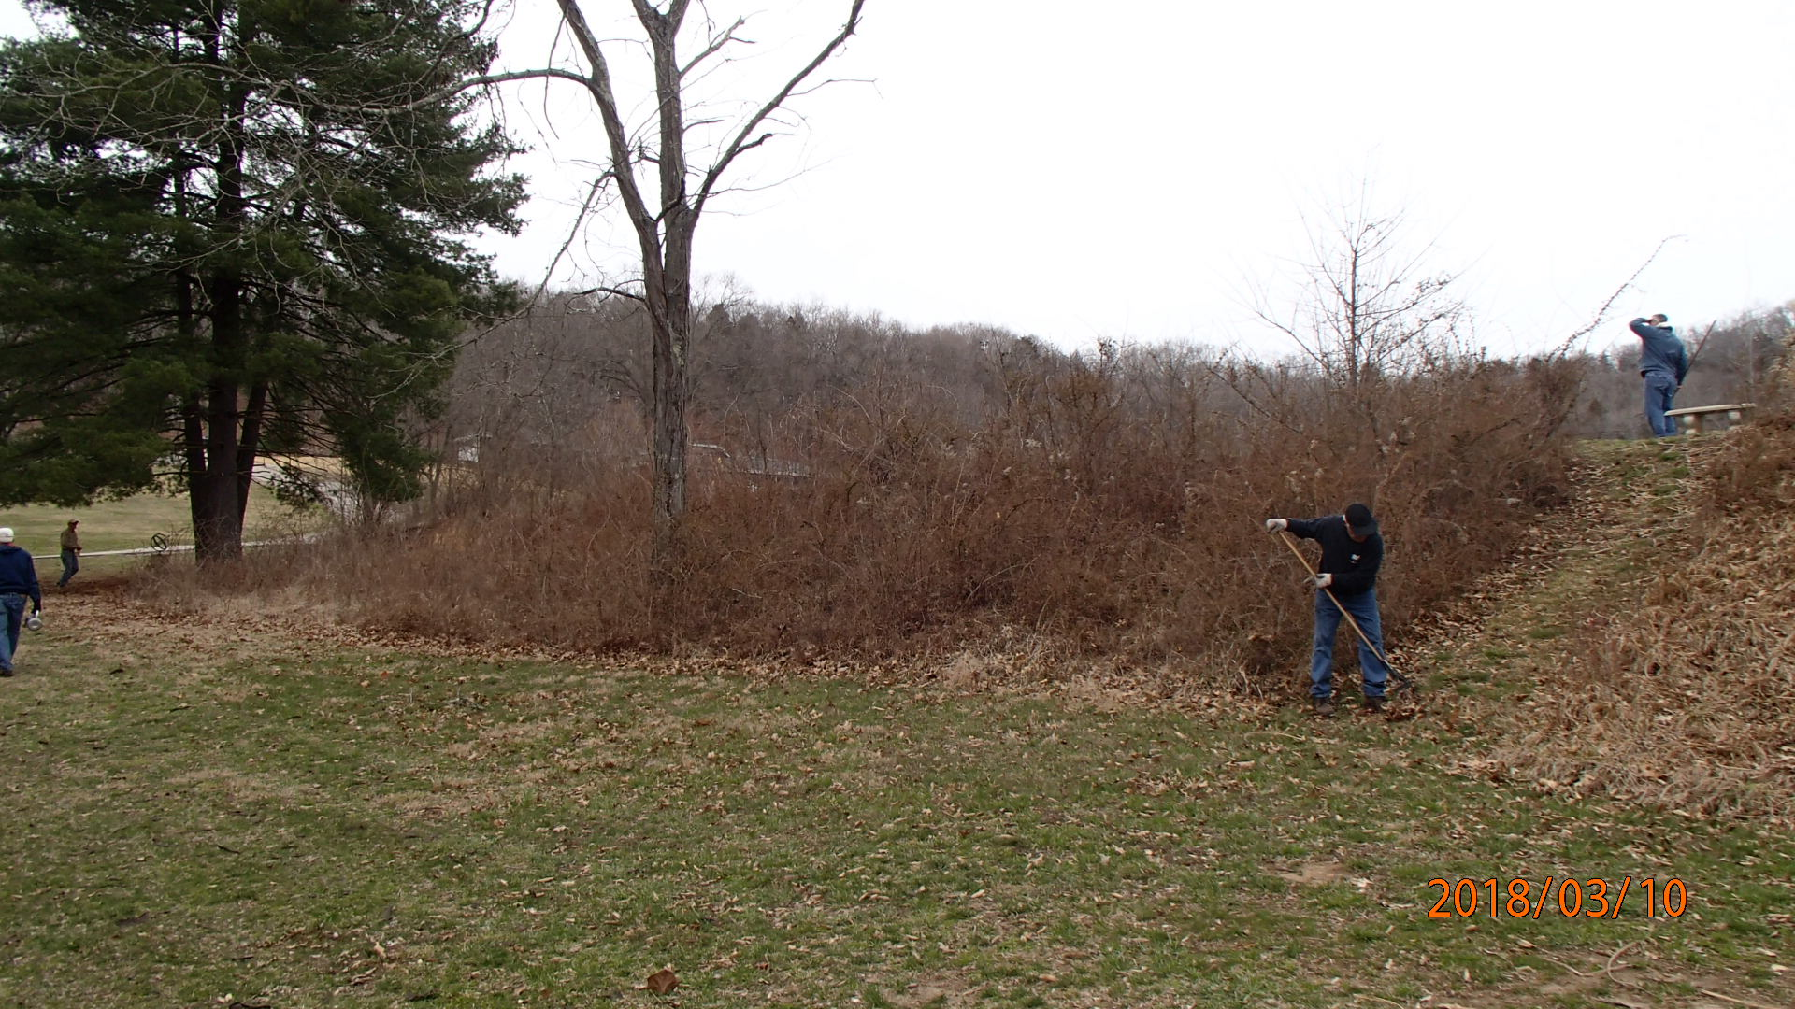
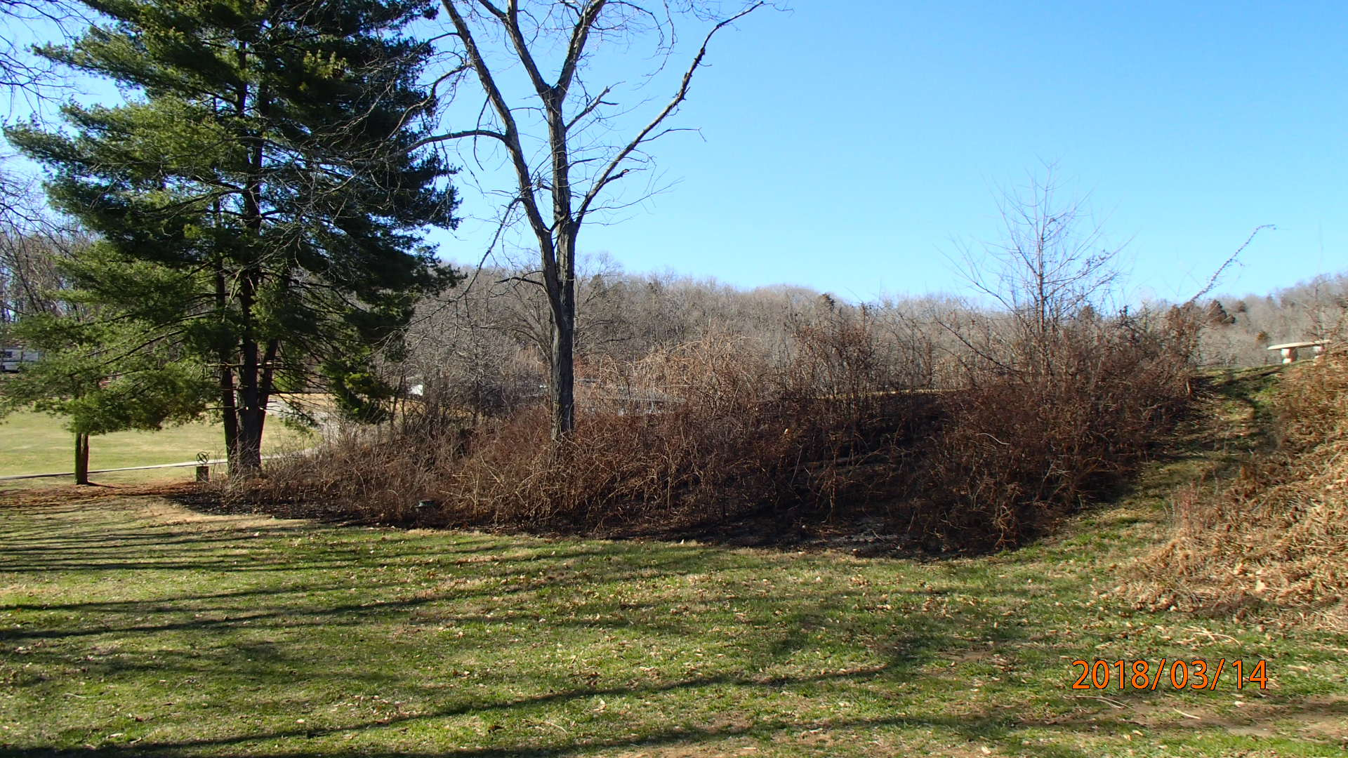

Slide 24
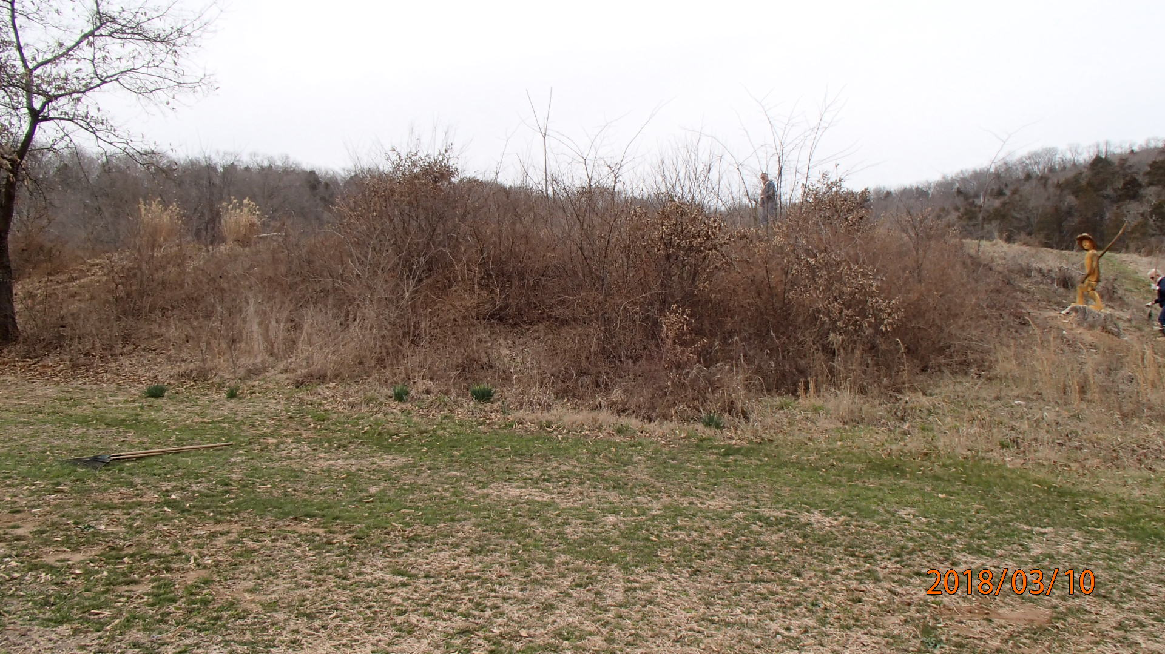
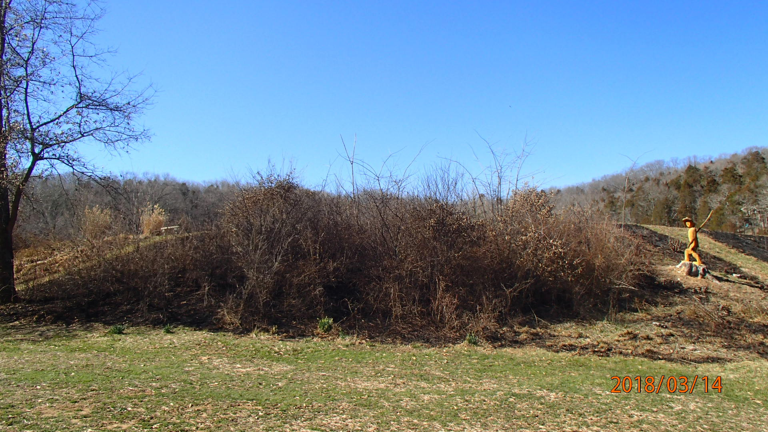

Slide 25
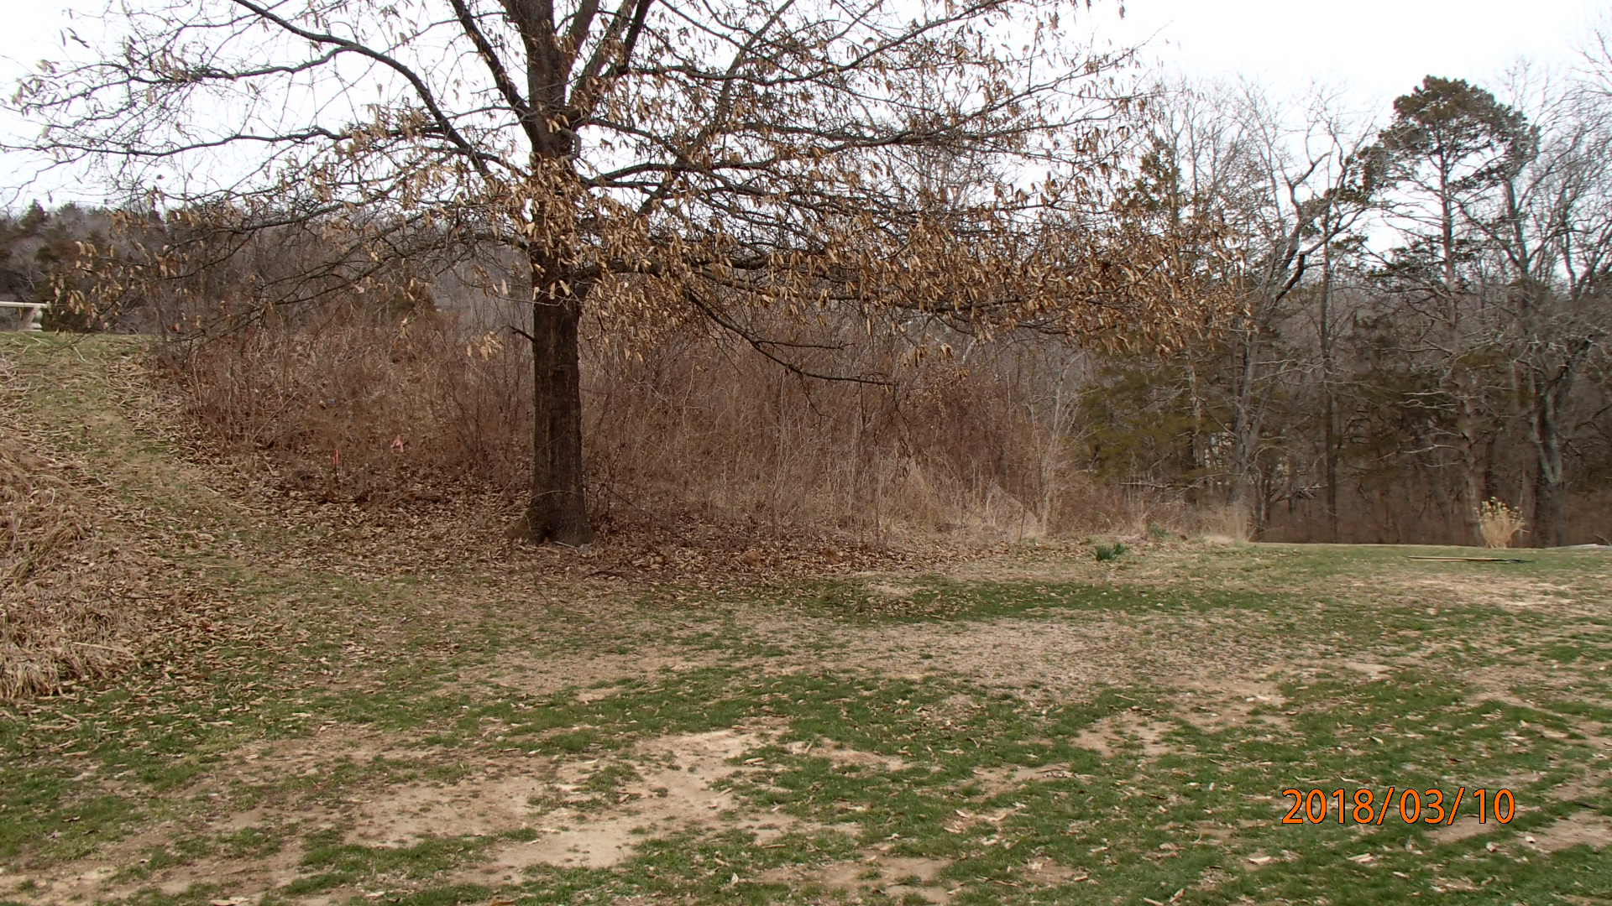
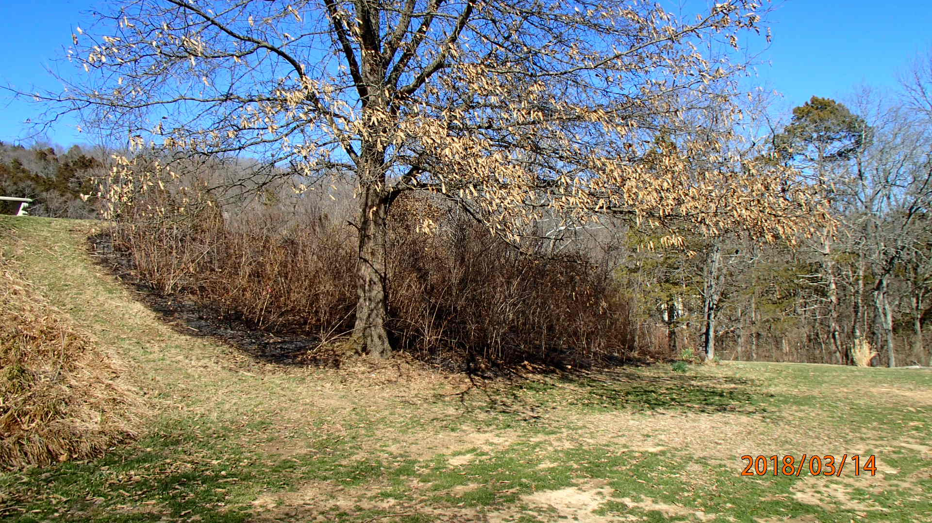

Slide 26
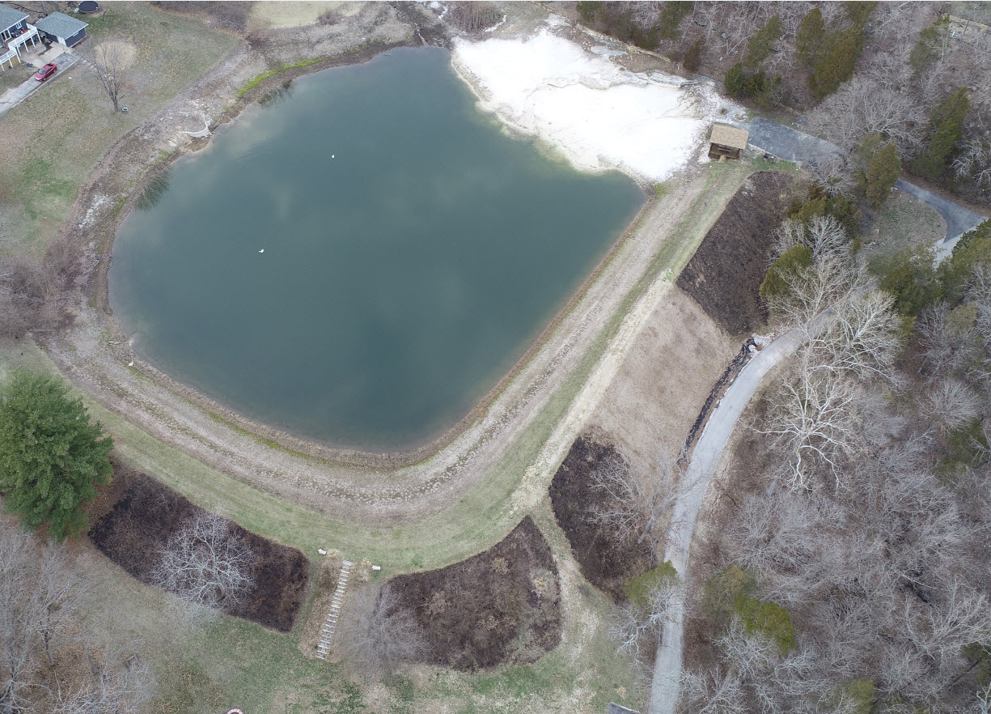

Slide 27
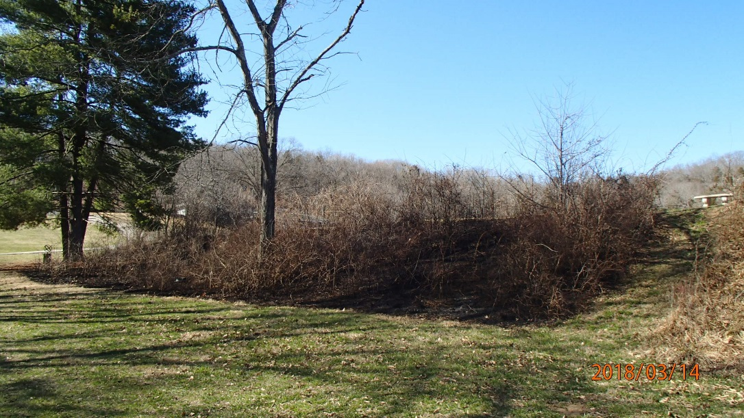
Now we need to remove all the “woody” vegetation.
Gem Lake

Slide 28
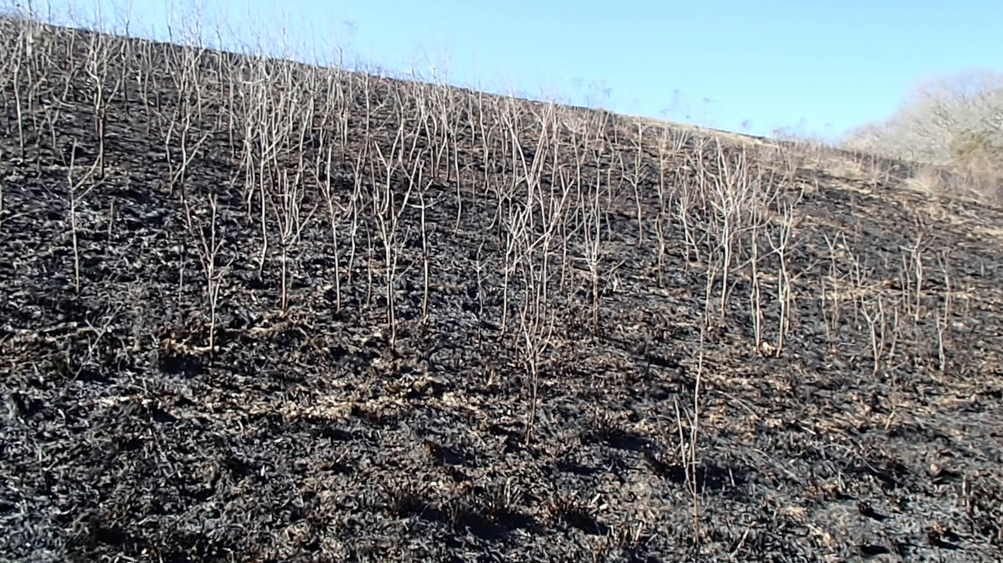
Crystal Lake

Slide 29
Questions?

Slide 30
Preservation and Enhancement Report

Slide 31
And what did you do the day after Thanksgiving?
We planted Milkweed Seeds!

Slide 32
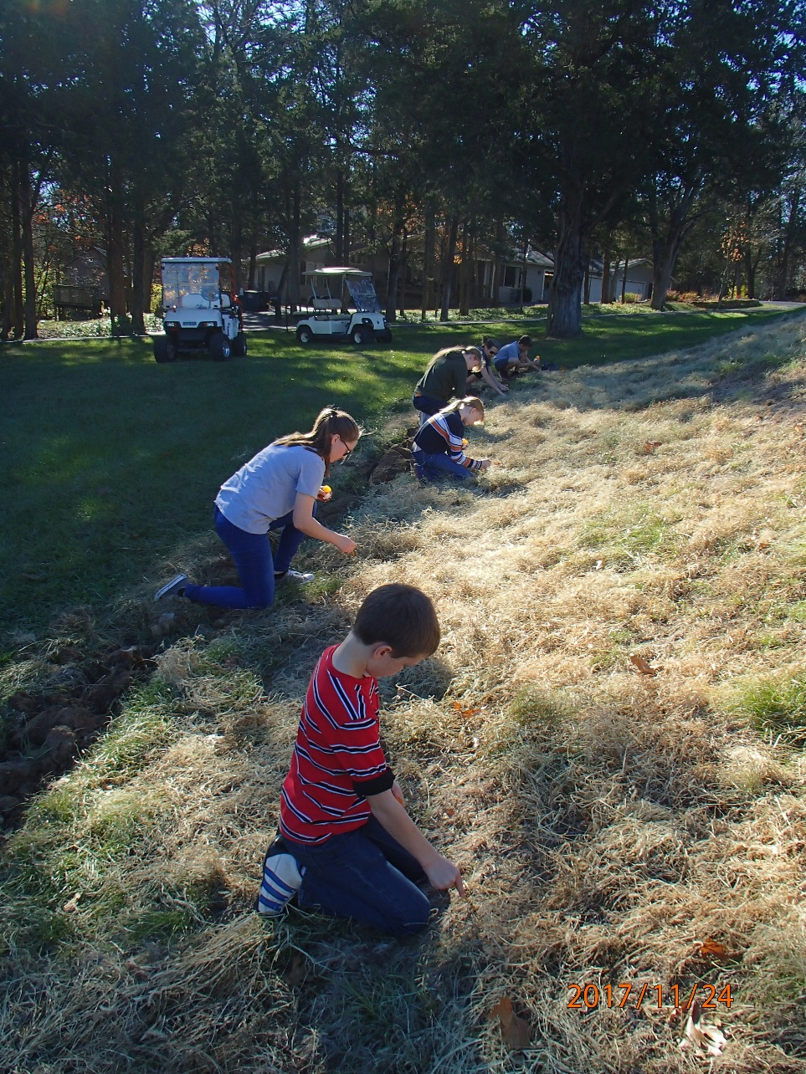
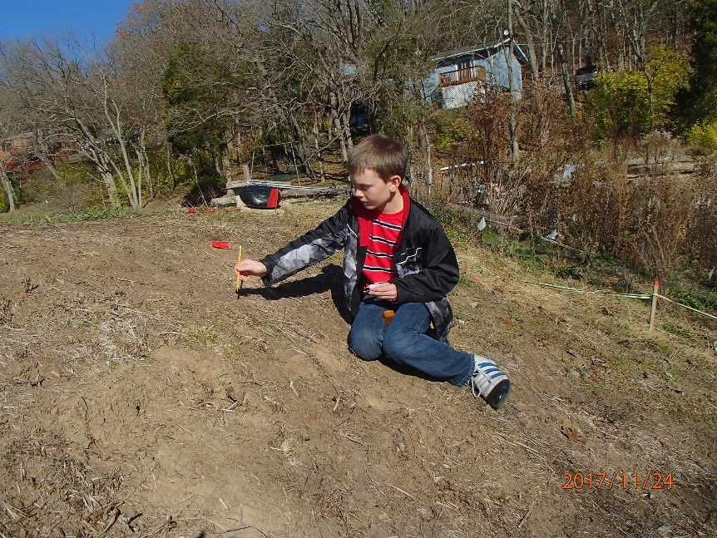
One at a Time! Crystal Lake

Slide 33
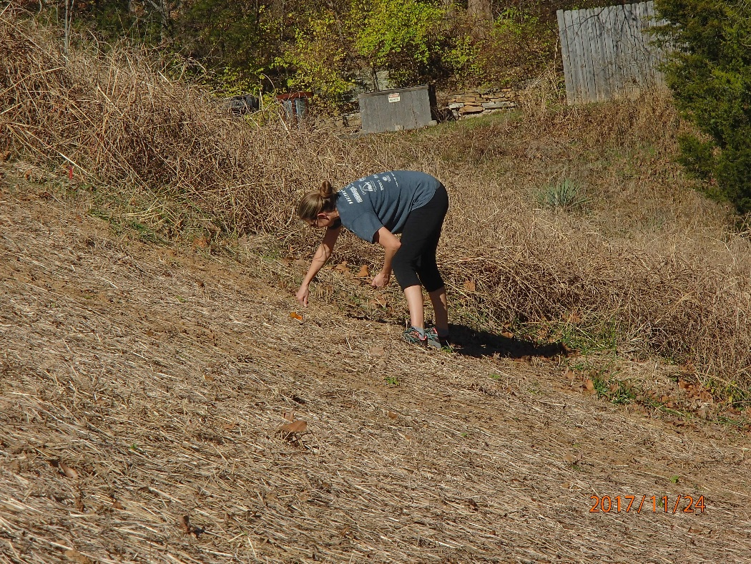
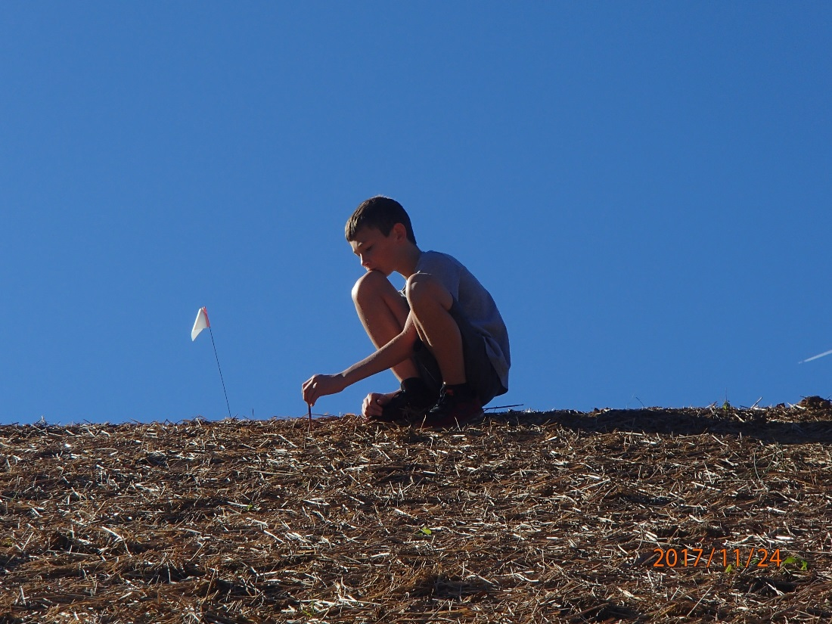
Gem Lake Dam
Ethan
Jessica

Slide 34
Then in January we broadcast a variety of perennial seeds.
See they NEED the cold winter to germinate.
Cold Moist Stratification

Slide 35
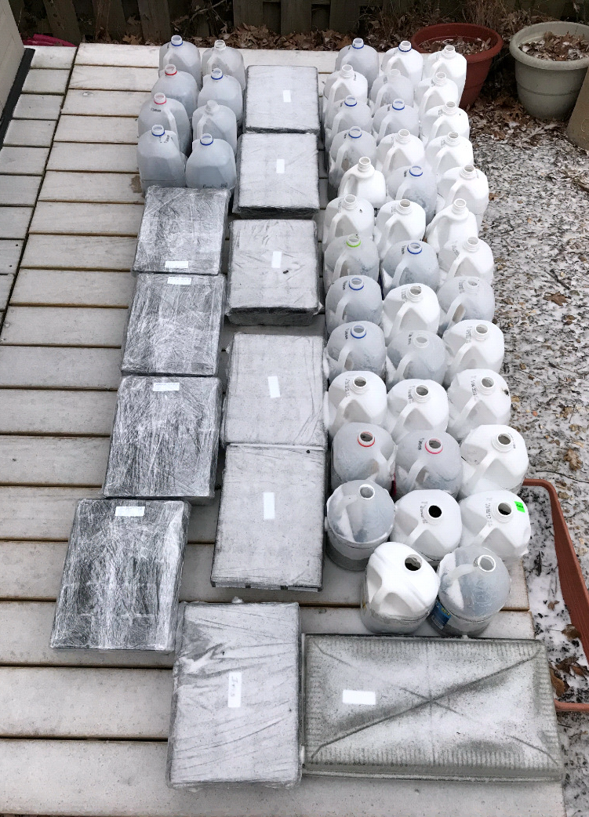
Also – planted a variety in containers that were placed outside.

Slide 36
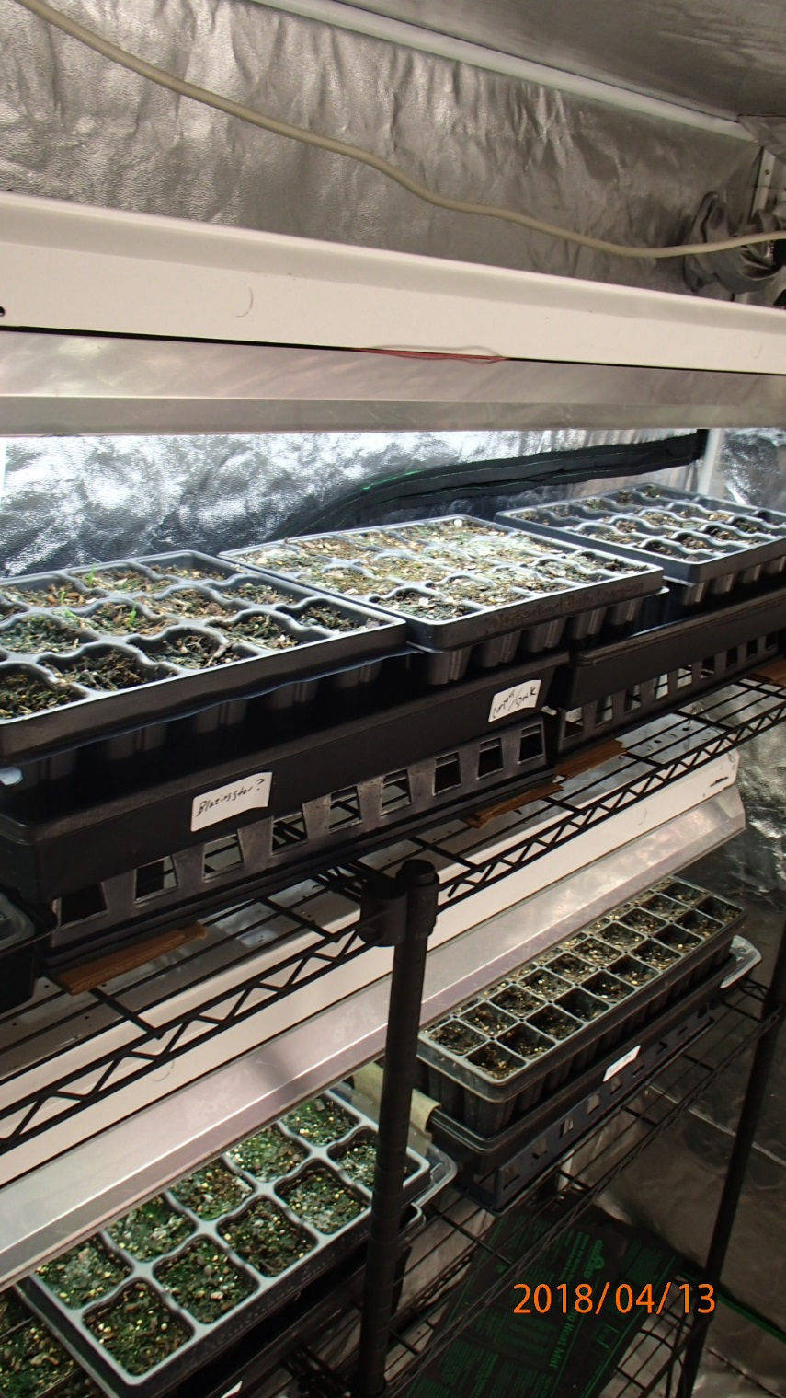
These were recently brought inside to warm up and germinate for early summer planting.

Slide 37
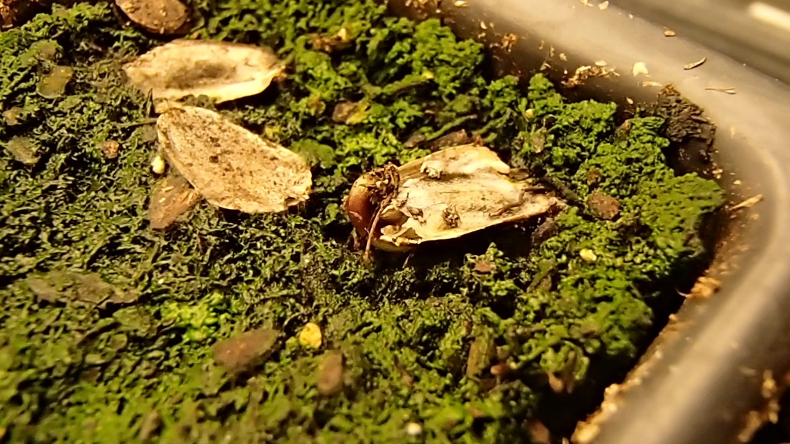
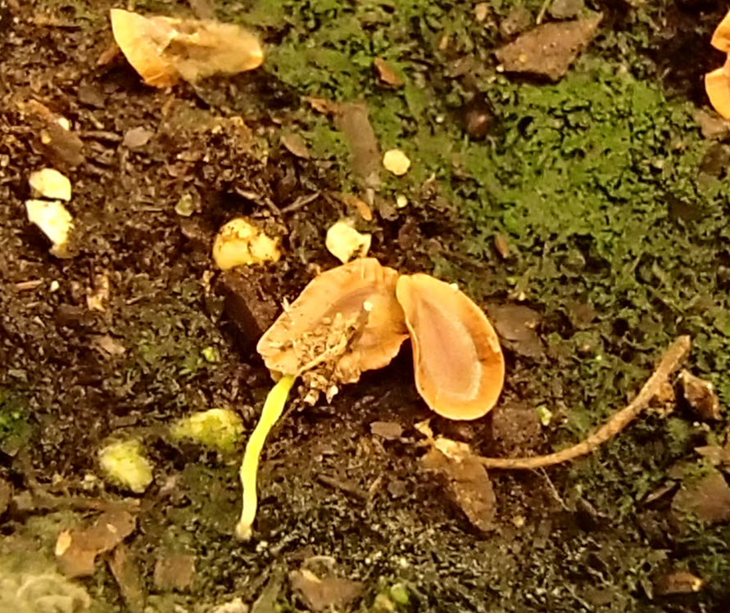
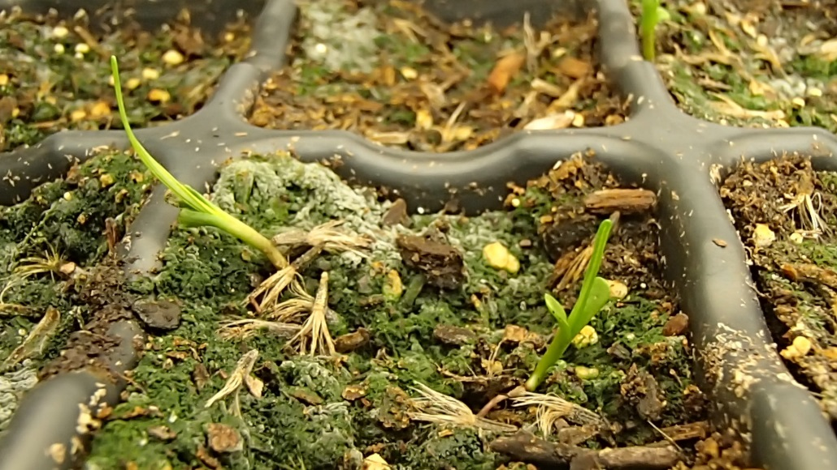

Slide 39
Wow! Lots of work – THANKS!!
Milkweed Planting Crew
Ethan and Jessica Devlin Fineran Children
Josh Higgins
Perscribed Burn Crew
Tim Wood Jim and Jeannie Meyer Bill Vogt
Ron Nuetzel Glen Pesta
Good Neighbors and Wonderful People!!

Slide 40
There is ALWAYS something that you can do to help beautify our neighborhood.
If you have ideas for ways you would like to see our surroundings enhanced, please let me know.

Slide 41
Know anyone needing community service hours,
scout volunteer project?
We need you!
“Chores”
Planting perennial plants
Weeding
Honeysuckle removal
Watch NextDoor

Slide 42
Happy National Volunteer Week!

