Slide 1
Pollinator Garden

Slide 2
August 2016

Slide 3
Garden Plan

Slide 4
Gather a planting team and….

Slide 5
September 2016

Slide 6
By October the plants looks really great, but the grass is coming back!

Slide 7
In February, removed the erosion blanket.

Slide 8
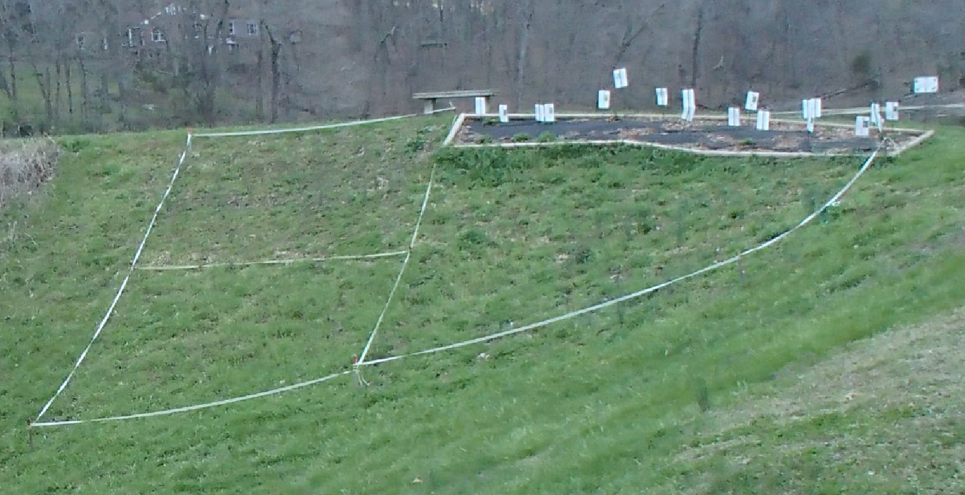
March 2017

Slide 9
April 2017

Slide 10
Honeysuckle at Gem Lake

Slide 11
January

Slide 13
The Lady Crew!

Slide 14
February

Slide 16
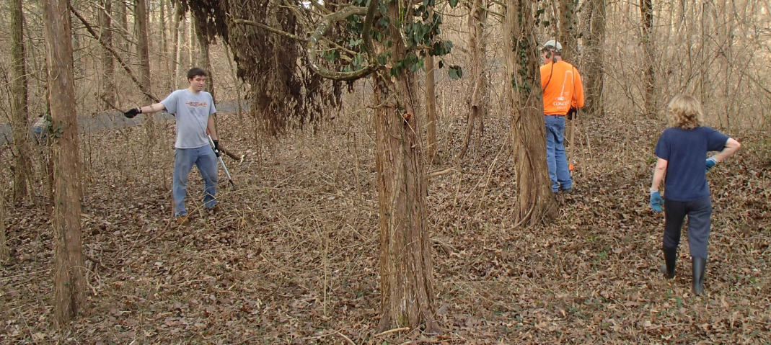
February Crew
Brian David Lyle Hardin
Josh Higgins Carol Bristle

Slide 17
March

Slide 23
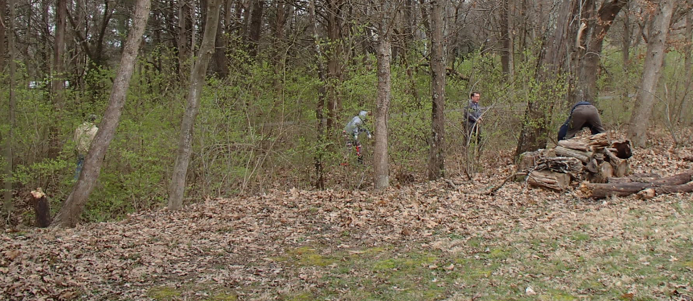
The Crew
Brian David Mike Roesch
Carol Bristle Craig Bristle
Tony Catalano

Slide 24
And let’s don’t forget our Burn Boss!

Slide 25
How about a big round of applause for our WONDERFUL volunteers!!!

Slide 26
Why do we care about honeysuckle?

Slide 27
Now, what can you do?
Look around your property, where is the honeysuckle growing?
When you decide to get started, don’t pick the worst areas, pick the edge areas or areas where you can remove all of the plants in a couple hours. This is really hard work, but seeing results will keep you motivated.

Slide 28
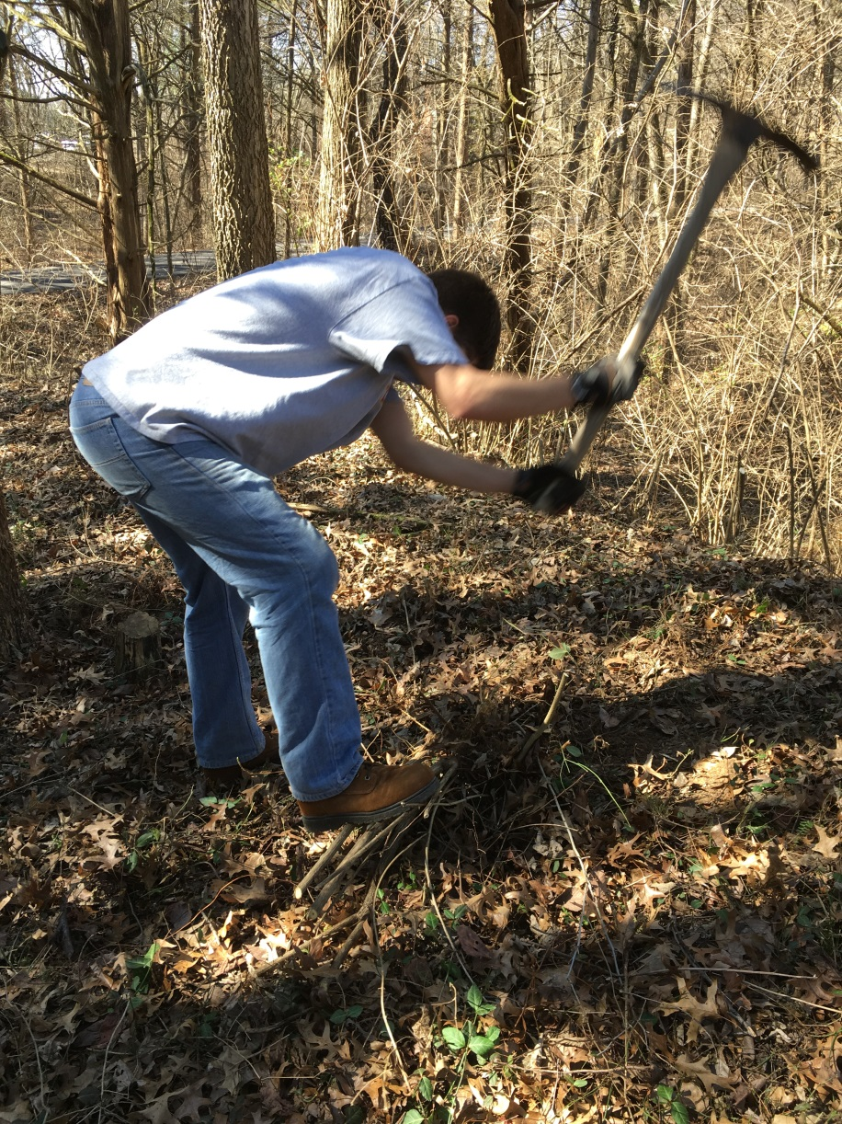
How do you remove it?
You can use
a pick axe.

Slide 29
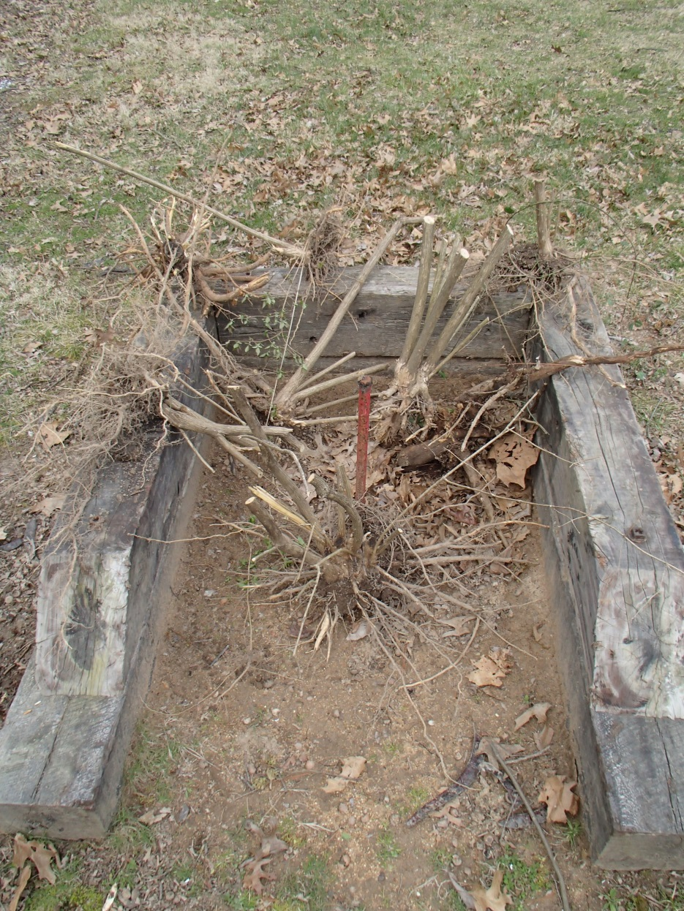
Very important
to get the
entire root.
And they
can be
BIG!

Slide 30
But there is an easier way – the “UpRooter”

Slide 31
And thanks to our LWH Board
You have access to new tools!
Just contact
Judy Meixner
636-938-4840
To reserve them!

